Slide 1
Global Phytosanitary Research Coordination
Stephanie Bloem

Slide 2
1. Harmonization of electronic data exchange
Global Phytosanitary Research Coordination
Why? | International research collaboration across nations, institutions and disciplines may … avoid duplication lead to efficiencies in resource use lead to wider adoption of results Benefits may only occur if/when there is an alignment of research goals and well thought out roadmap for collaboration

Slide 3
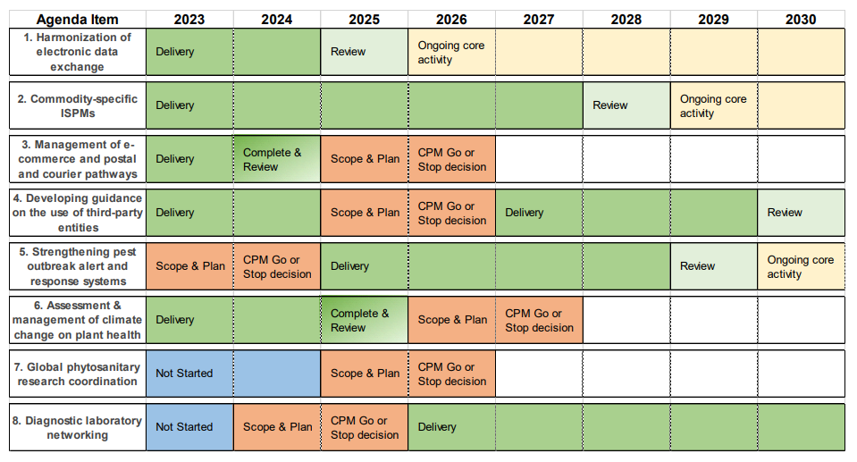

Slide 4
Future CPM Focus Group
The draft Terms of Reference will be presented to CPM-18 (2024) for approval.
Planned call for experts in mid-2024.
Seven representatives from the 7 FAO regions; 1 representative each from CPM Bureau, Standards and Implementation Committees, and Regional Plant Protection Organizations.

Slide 5
Future CPM Focus Group – expertise
Deep understanding of IPPC’s mandate and activities
Familiar with the functioning of National Plant Protection Organizations and Regional Plant Protection organizations
Experience in multilateral research cooperation, policies and arrangements

Slide 6
CPM Focus Group – objective & key tasks
Develop an implementation plan that includes
Timelines and milestones
How to monitor and evaluate progress
Estimated budget and staff to operationalize this program
During Scope and Plan phase (2025)
examine mechanisms that already exist (such as EUPHRESCO)
what gaps (if any) the IPPC should fill
how the IPPC can contribute to support

Slide 7
How are EUPHRESCO and EPPO connected?
EPPO …
ensured long-term sustainability of EUPHRESCO by agreeing to host this research coordination network in 2014
actively contributes to, interacts with, and supports EUPHRESCO
incorporated EUPHRESCO into the NPPO network in the EPPO region and in the IPPC community
fulfills one of EPPO’s functions: to facilitate cooperation in research on pests and methods of control

