Slide 1
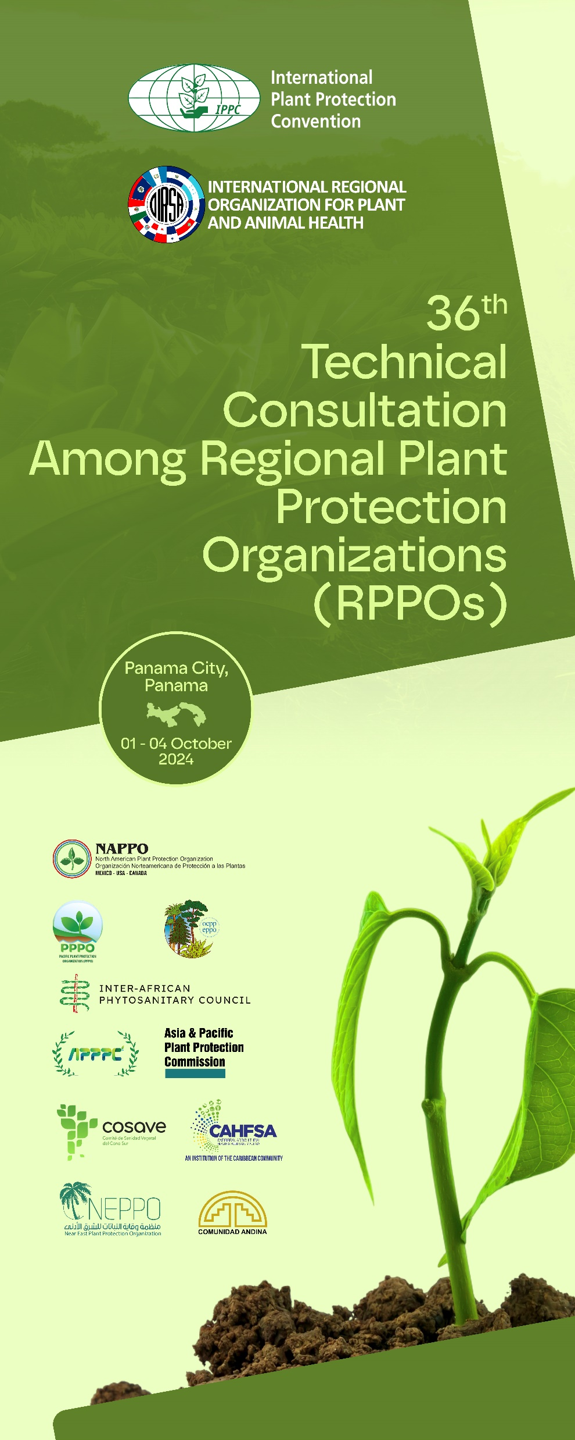
Roles and Functions of RPPOs in their relationship with the Commission on Phytosanitary Measures (CPM)
Raúl Rodas – Executive Director
Carlos Urias – Plant Health Regional Director
Xavier Euceda – Project and Program Plant Health

Slide 2
The ten RPPOs*
1951 - EPPO - European and Mediterranean Plant Protection Organization
1953 - OIRSA - Organismo Internacional Regional de Sanidad Agropecuaria
1956 - IAPSC - Inter-African Phytosanitary Council
1956 - APPPC - Asia and Pacific Plant Protection Commission
1969 - CAN - Comunidad Andina
1976 - NAPPO – North American Plant Protection Organization
1989 - COSAVE - Comité de Sanidad Vegetal del Cono Sur
1994 - PPPO - Pacific Plant Protection Organization
2012 - NEPPO - Near East Plant Protection Organization
2017 - CAHFSA – Caribbean Agricultural Health and Food Safety Agency
Notes:
APPC The Asia-Pacific Plant Protection Commission (APPPC) convened for the first time in 1956.
CAHFSA
CAN 1969 Suscripción del Acuerdo de Cartagena – 1996 El Acuerdo de Cartagena toma el nombre de Comunidad Andina.
COSAVE El Convenio Constitutivo de la Organización fue suscripto el 9 de marzo de 1989 como culminación de un proceso iniciado en el año 1979,
5. EPPO The Convention for the establishment of EPPO was signed on the 18th of April 1951 in Paris and is deposited at the French Ministry of Foreign Affairs. It has since been amended several times by the EPPO Council. The last amendments were agreed in September 1999, and had the principal aim of taking due account of the last revisions made to the IPPC.
6. AU-IAPSC was established on recommendation of FAO in 1956 in London and became part of the Organization of African Unity (OAU) in 1965. In 1967 the Headquarters of the Council was transferred from London to Yaoundé, Cameroon.
8. NEPPO The Agreement for the establishment of the Near East Plant Protection Organization was signed in 1993 in Rabat and entered into force on 2009-01-08. NEPPO was formally recognized as a Regional Plant Protection Organization (RPPO) under the IPPC on 23 March 2012
9. OIRSA 29 October 1953
10. PPPO The Pacific Plant Protection Organisation (PPPO) was founded in October 1994 by the South Pacific Conference…

Slide 4
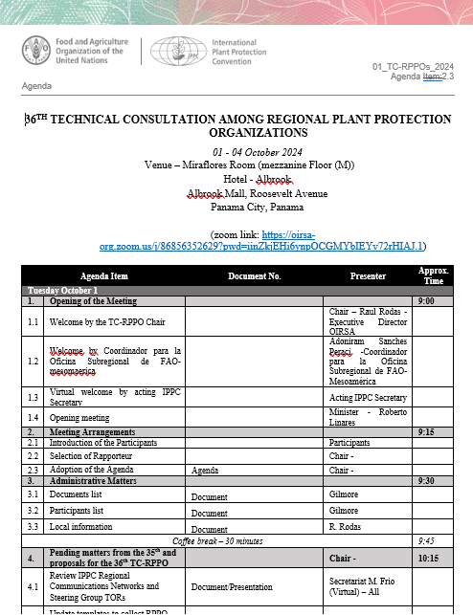

Slide 5
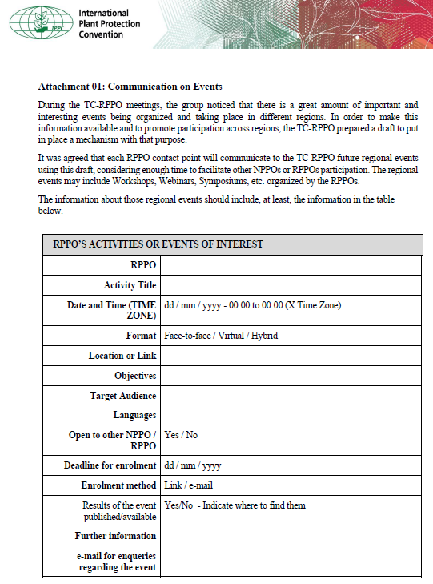
Update templates to collect RPPO communication on Events and sharing information about Pests of Concern

Slide 6
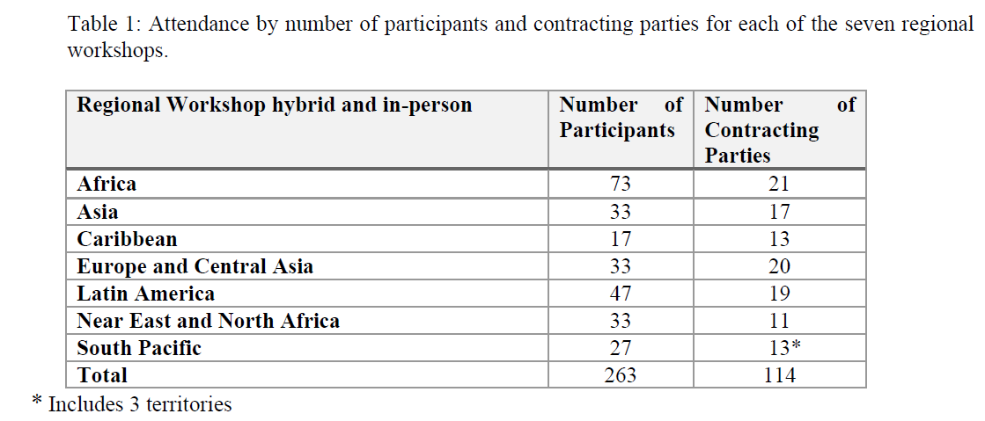
Conclusions and Discussions about IPPC Regional Workshops

Slide 7
RPPO & Other Organizations - Information

Slide 9
Conclusions 36th TC RPPO

Slide 10
The final report will be presented at CMF 19 in FAO – Rome through OIRSA. Next meeting: Rabat-Morocco 2025

