Slide 1
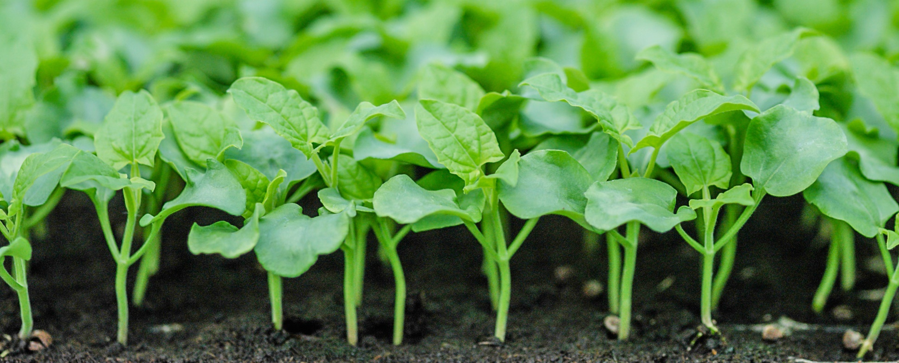
Protecting Plant Health Through Strong Partnerships
47th Annual Meeting
North American Plant Protection Organization
Dr. Mark L Davidson
Deputy Administrator
Plant Protection and Quarantine

Slide 3
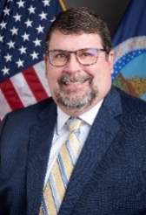
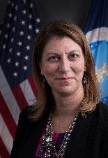
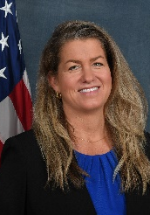
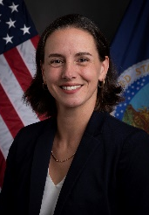
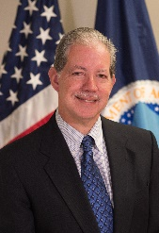
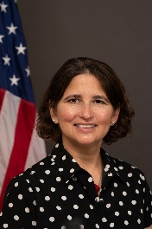
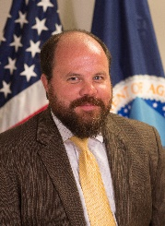
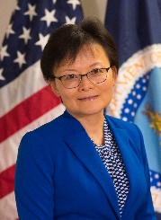
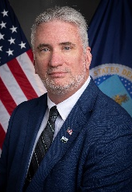
PPQ Leadership and Organizational Structure
Plant Protection and Quarantine
Mark Davidson
Deputy Administrator
Samantha Simon
Associate Deputy Administrator
Business and Employee Services
Emergency and Domestic Programs
Field Operations
Int’l Phytosanitary Management and Standards Program
Pest Exclusion and Import Programs
Science and Technology
Carrie Thomas Associate Deputy Administrator
Nicole Russo Associate Deputy Administrator
Carlos Martinez Associate Deputy Administrator
Jessica Mahalingappa
Acting
Associate Deputy Administrator
Matt Rhoads Associate Deputy Administrator
Wendy Jin Associate Deputy Administrator
Calvin Shuler Executive Director

Slide 4
Agricultural Quarantine and Inspection (AQI) User Fee Rule
In May, APHIS finalized a new rule amending AQI program user fee regulations
Under the final rule, most AQI user fees will increase
The changes were effective on 10/1/24
Exception: Delaying the implementation of the commercial aircraft user fee for aircraft with 64 or fewer seats until 4/1/25

Slide 5
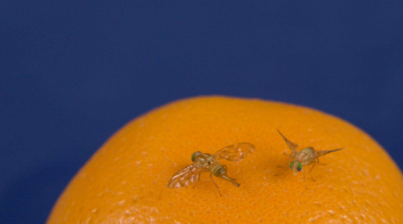
California Fruit Fly Eradication Successes
Summer of 2023 saw a surge of invasive fruit fly species in California
Species included Oriental, Z. tau, Mediterranean, and Queensland
Using emergency funding, PPQ and the State eradicated all 2023 quarantines
Emergency funds also addressed fruit fly incursions in areas of Guatemala and Mexico

Slide 6
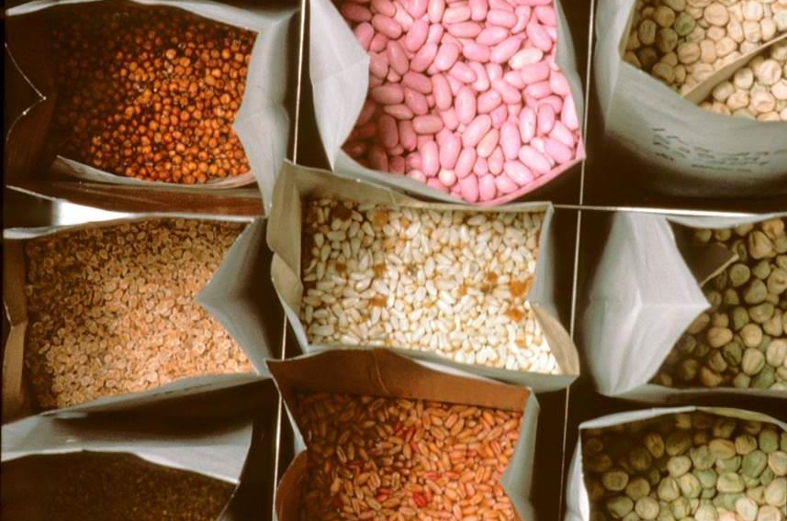
Regulatory Framework for Seed Health (ReFreSH)
Will result in a more effective and efficient program for managing risk associated with international seed movements
Continuing our ReFreSH pilot with Chile to exchange small lots of seed
Planning pre-harvest and production or harvesting audits
Next steps: planning for reciprocal production of corn seed under ReFreSH in the United States

Slide 7
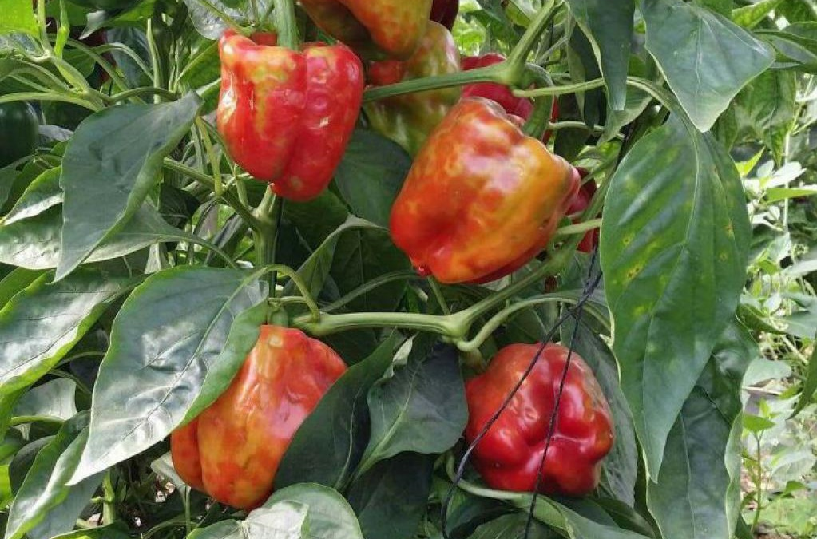
Tomato Brown Rugose Fruit Virus
August 2023: PPQ provided stakeholders with two ToBRFV pathway analyses plus regulatory options to consider—and requested comments
Assessed likelihood of introducing ToBRFV into the U.S. via:
Fresh fruit for consumption
Propagative plant material
Concluded fresh fruit for consumption is an unlikely pathway
Amended Federal Order, rescinding the import requirements for tomato and pepper fruit for consumption from all countries

Slide 8
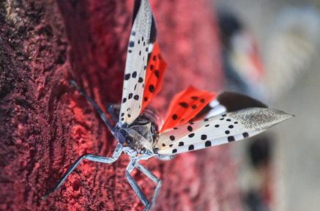
Much progress since we published the 5-year strategy in June 2023:
PPQ and collaborators have updated and revised risk models
A joint PPQ and National Plant Board Research Facilitation Group is identifying research needs and gaps
Gov’t communicators are increasing outreach, targeting at-risk industries and establishing consistent national messaging
Spotted Lanternfly

Slide 9
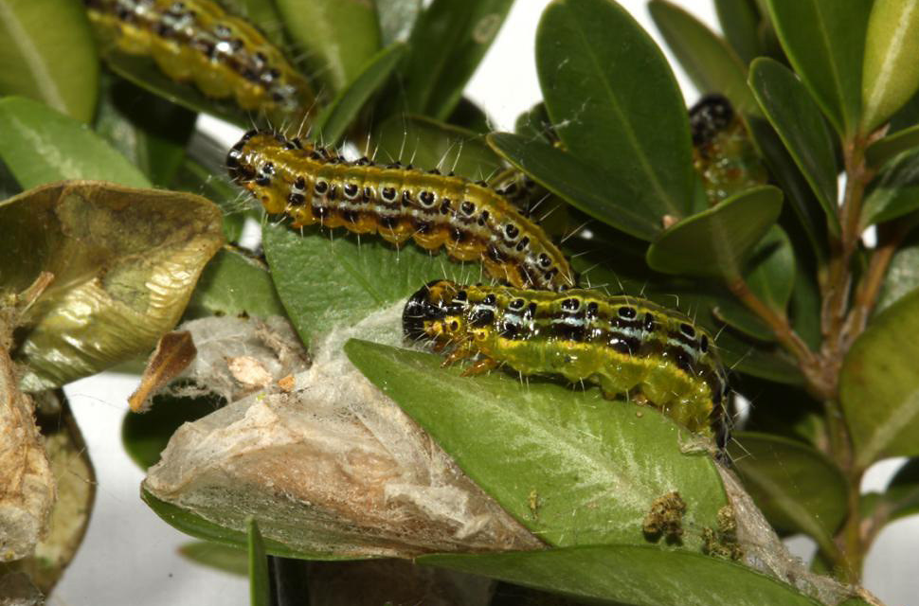
Box Tree Moth Compliance Agreement
May 2024: Issued a Federal Order that established conditions for the interstate movement of boxwood
The compliance agreement allows for safe movement of boxwoods from BTM quarantines, under a State-issued certificate
The State compliance agreement outlines specific requirements: treatments, inspections, trapping, etc.

Slide 10
Thank you!
47th Annual Meeting
North American Plant Protection Organization
Dr. Mark L Davidson
Deputy Administrator
Plant Protection and Quarantine

