Slide 1
How NAPPO Contributes to the Implementation of Regional (RSPMs) and International (ISPMs) Standards
Alonso Suazo
47th NAPPO Annual Meeting
Tucson, AZ

Slide 2
Implementation of RSPMs and ISPMs
RSPMs and ISPMs play a crucial role in protecting sustainable agriculture, global food security, the environment, forests, and biodiversity while facilitating safe trade and economic development.
The implementation of RSPMs and ISPMs is up to the National Plant Protection Organizations (NPPOs).

Slide 3
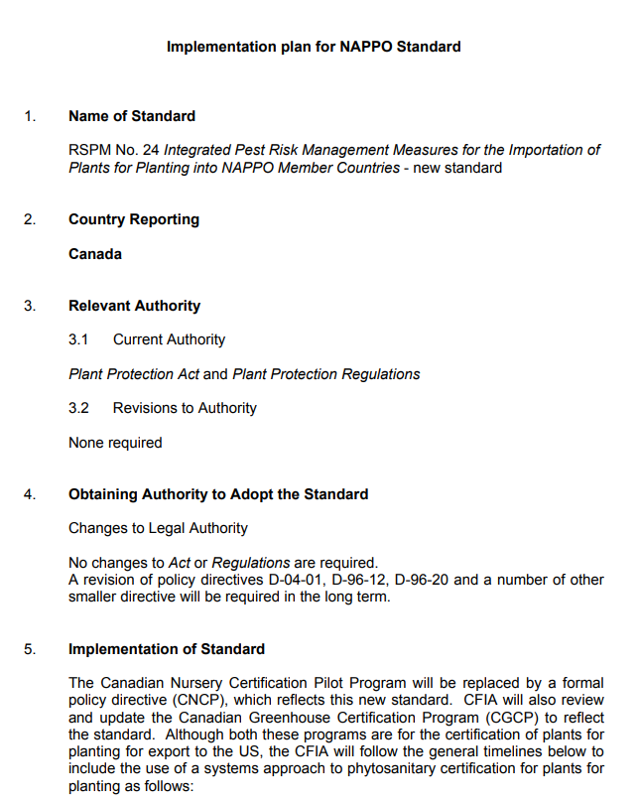
RSPM Implementation Plans
Regional Standards for Phytosanitary Measures (RSPM) :: nappo.org

Slide 4
How does NAPPO Contributes with the Implementation of Standards
Organizing workshops, seminars, and other events
Producing relevant documents
Providing summaries of RSPM to inform stakeholders about the purpose and content of each standard.

Slide 5
Workshops
Implementation of ISPM 15 (Regulation of wood packaging material in international trade)
Implementation of ISPM 38 (International movement of seeds)

Slide 6
Relevant NAPPO Documents
Guidance document 01 (Standardization of responsibilities and actions for safeguarding consignments that have transited one NAPPO member country to enter another NAPPO member country)
RSPM 23 (Guidelines for consignment in transit-archived) and ISPM 25 (Consignment in transit)

Slide 7
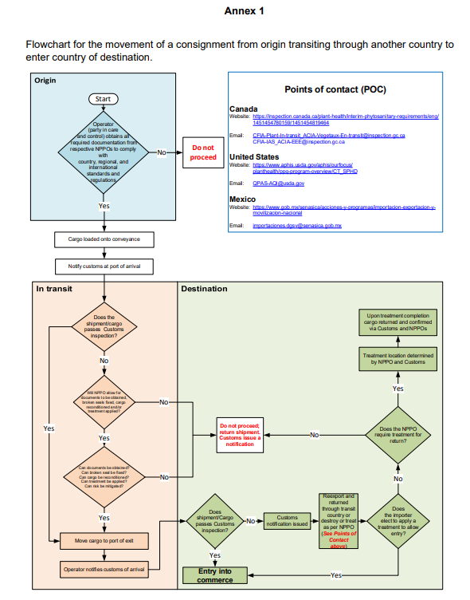
Points of contact in each NAPPO country for non-compliance cases:
Website
email
In transit movement of commodities in the NAPPO region

Slide 8
RSPM Summaries in the NAPPO Website
One-pagers that:
Provide basic information on the purpose and content of Regional Standards
Available in the NAPPO website (www.nappo.com) for RSPMs that are not archived.

Slide 9
Thank you! ¡Gracias!

