Slide 1
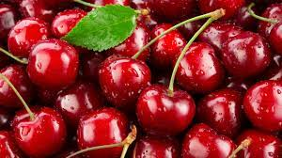
Pacific Northwest Tree Fruit Grower Perspectives on Methyl Bromide
Virna Stillwaugh, Ph.D.
Vice President for Scientific Affairs
Northwest Horticultural Council
The North American Plant Protection Organization Annual Meeting
October 24, 2024

Slide 2
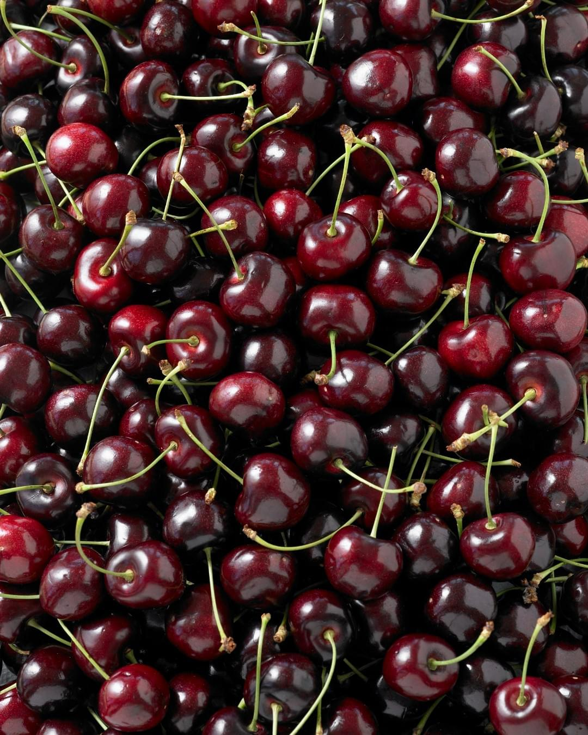
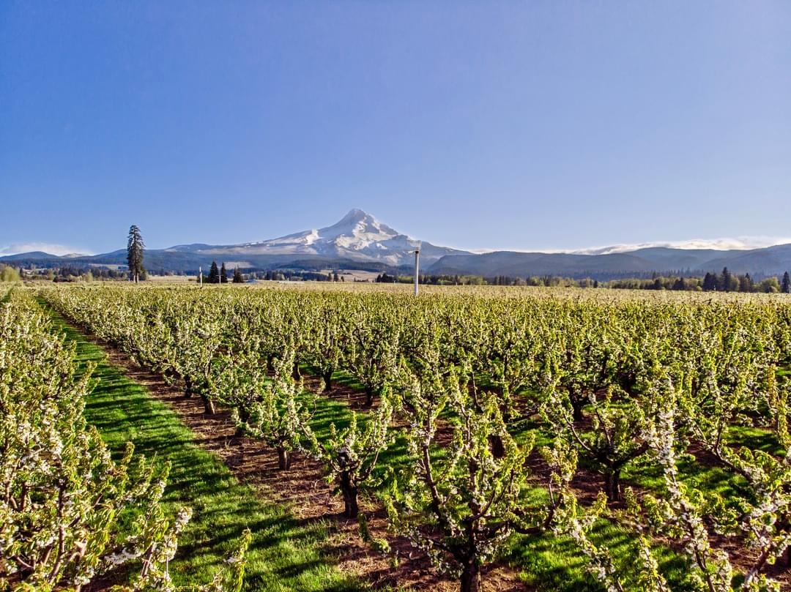
Northwest Horticultural Council (NHC)
Established in 1947.
Represents the growers, packers, and shippers of apples, pears, and cherries in Washington, Oregon, and Idaho.
Our growers produce 64% of the apples (74% of U.S. fresh market), 85% of the fresh pears and 67% of the fresh sweet cherries in the U.S.

Slide 3
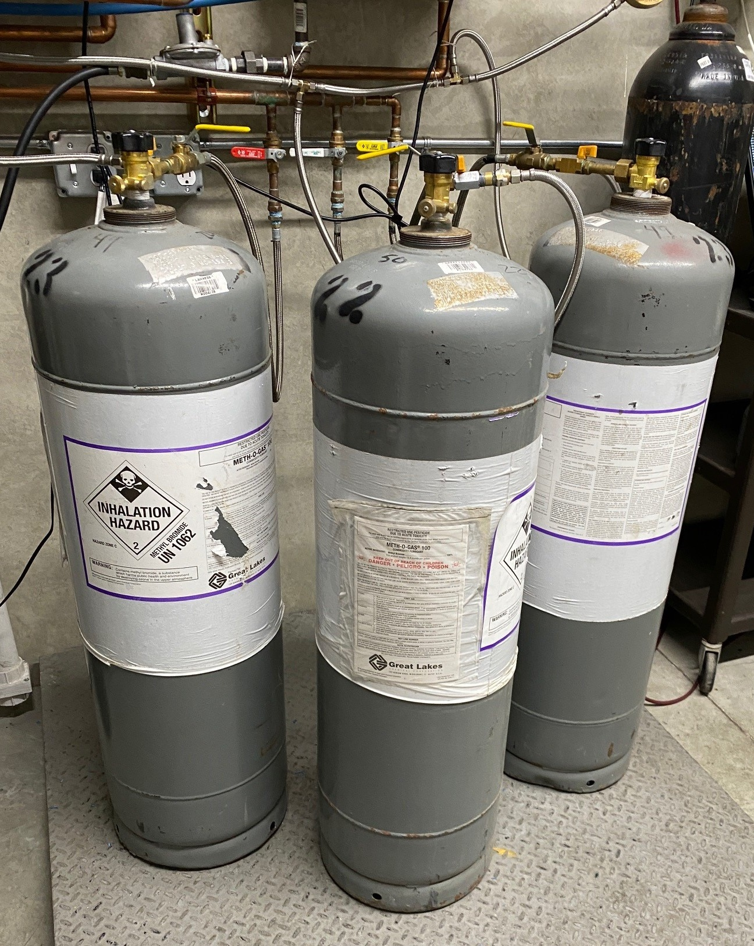
Methyl bromide
Odorless, colorless, non-flammable gas
Commercial fumigant since 1930
Controls a variety of agricultural pests, including fungi, weeds, insects, nematodes and rodents
Quarantine treatments
Fast acting (<24 hrs)
Highly toxic
Ozone depleter

Slide 4
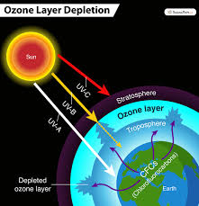
The phaseout of methyl bromide
Class I ozone depleter subject to first round of phaseout targets under the Montreal Protocol
Amount of methyl bromide produced and imported reduced incrementally until it was phased out on January 1, 2005
Certain uses are exempt:
  Critical uses
  Quarantine and pre-shipment uses
Source: https://www.epa.gov/ods-phaseout/phaseout-class-i-ozone-depleting-substances

Slide 5
Methyl bromide critical uses
Users can apply for an exemption.
Authorized by EPA rulemaking and parties of the Montreal Protocol
Use deemed “critical” only if meets the following criteria:
  Lack of methyl bromide availability would result in a significant market disruption.
  No technically and economically feasible alternatives or substitutes are available.
Source: https://www.epa.gov/ods-phaseout/methyl-bromide

Slide 6
Methyl bromide for quarantine and preshipment
Exemption under the Montreal Protocol and the Clean Air Act allows production and consumption of MB for Quarantine and Preshipment (QPS) purposes:
Quarantine applications:
Fumigation prevents the introduction of a quarantine pest into a defined geographic area. Treatments must meet the requirements of the USDA's Animal and Plant Health Inspection Service (APHIS) treatment manual, or the listed treatments compiled by the National Plant Board.
Preshipment Applications:
Fumigate commodities within 21 days of export to meet the official requirements of the importing or exporting country.
Source: https://www.epa.gov/ods-phaseout/methyl-bromide

Slide 7
Methyl bromide importance to PNW tree fruit industry
Quarantine treatment used in international trade.
Pre-shipment fumigation when required by export protocols as a treatment for several insect pests, including, western cherry fruit fly, and spotted wing drosophila.
Pacific Northwest typical cherry season methyl bromide usage is 31 metric tons (2.4% of total U.S. use for quarantine and pre-shipment use) for specific export markets. For large volume export years, 43 metric tons (3.4% of total U.S. use for quarantine and pre shipment use) of methyl bromide can be used.
If pests are found in a shipment upon arrival, trading partners may fumigate the fruit, rather than destroy the shipment or have it re-exported (e.g., apples in Taiwan).

Slide 8
Methyl bromide importance to PNW tree fruit industry (cont.)
Quarantine fumigation of apples, pears, and cherries. Critical to maintaining access to export markets (>$63 million annually).
Apple export markets that require methyl bromide fumigation is Japan.
Cherry top export markets that require methyl bromide fumigation are Korea ($29 million), Australia ($4.6 million), Japan ($8 million), NZ ($100,000) and India ($173,202).
Potential new market (e.g., Israel) that has proposed methyl bromide fumigation as a condition for market access. Israel is estimated to become a $2.5 million market for cherries.

Slide 9
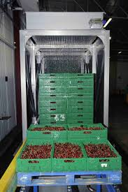
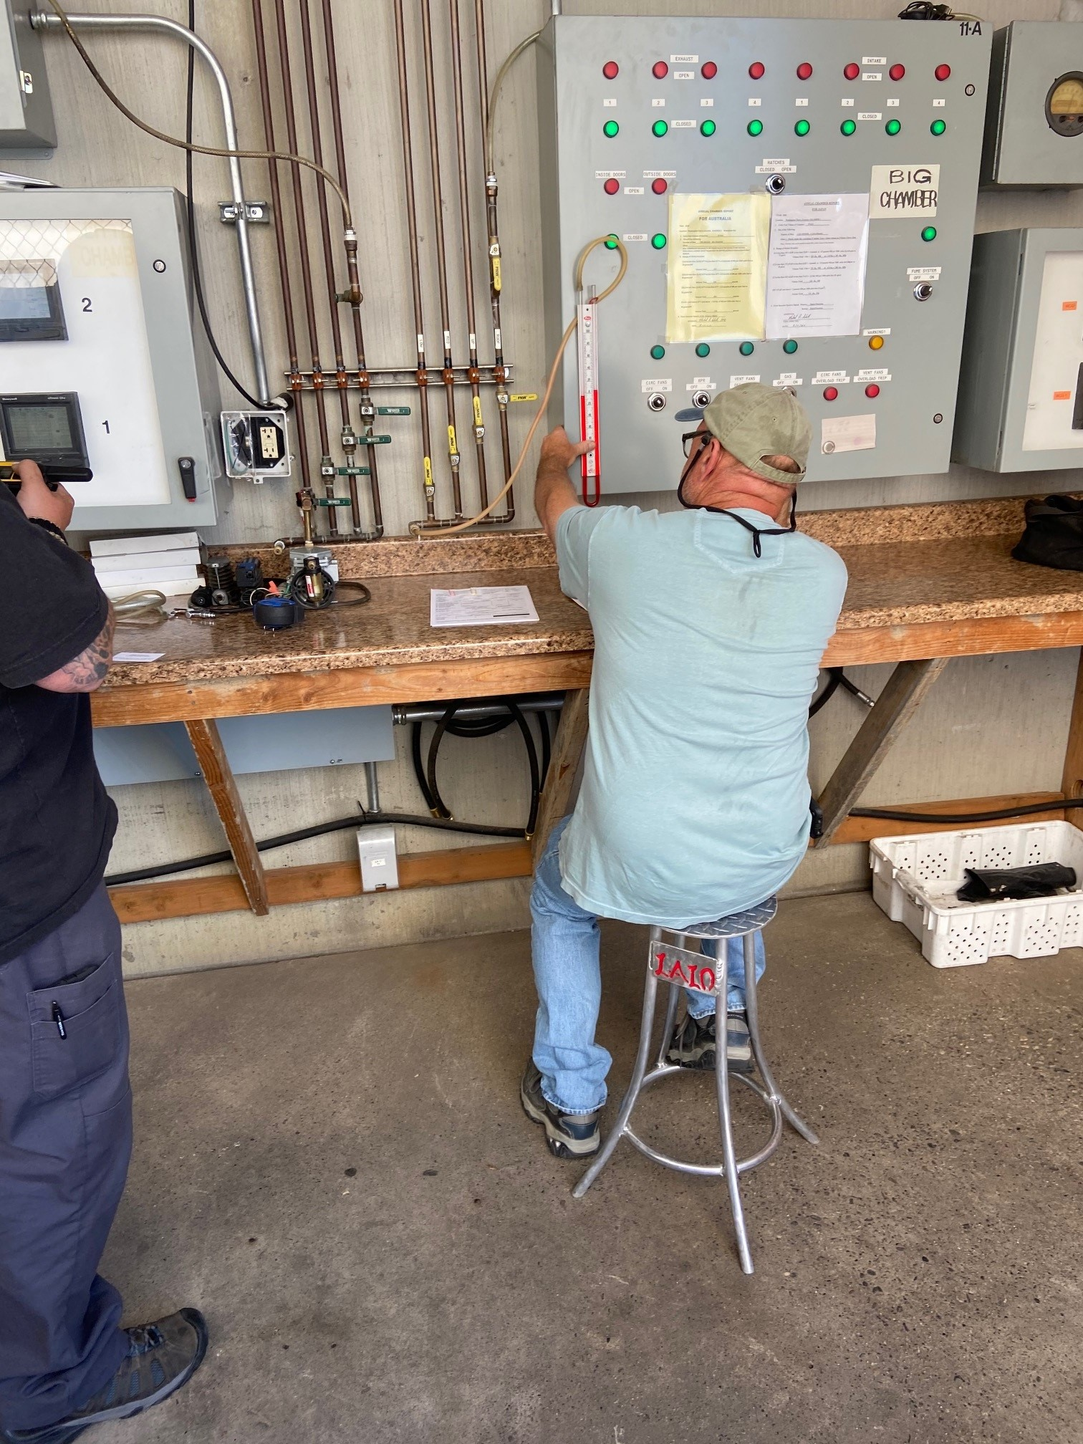
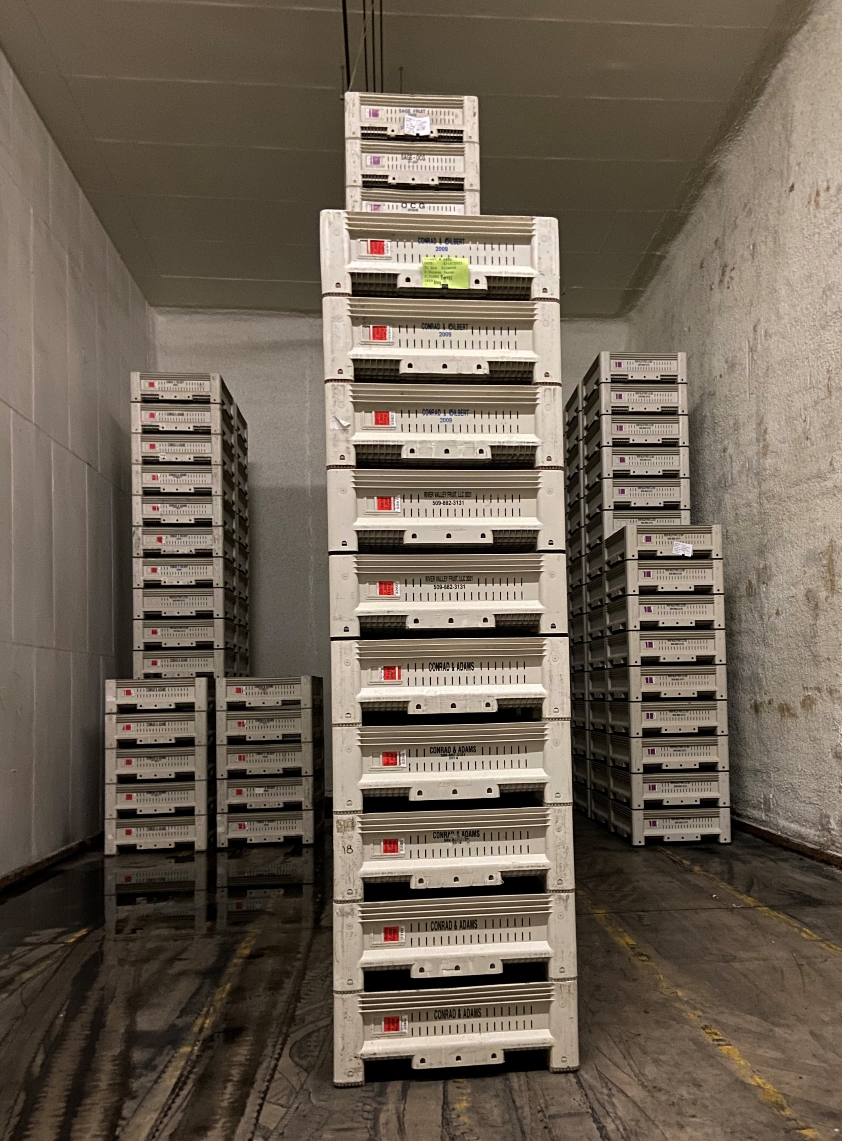
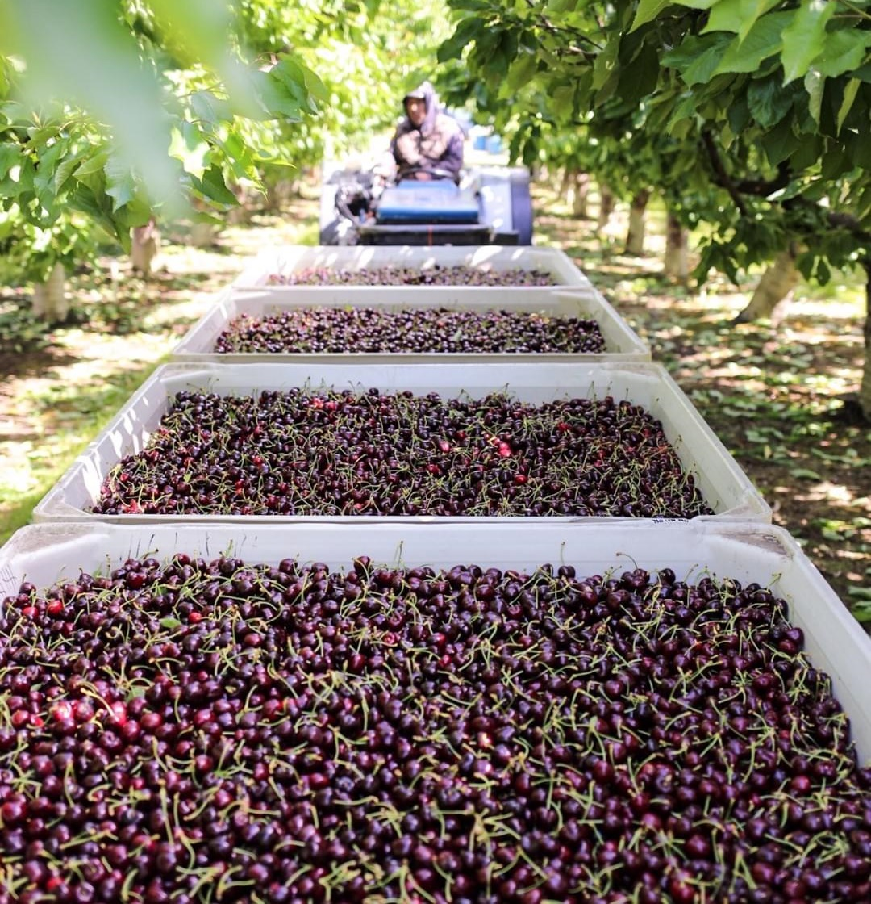
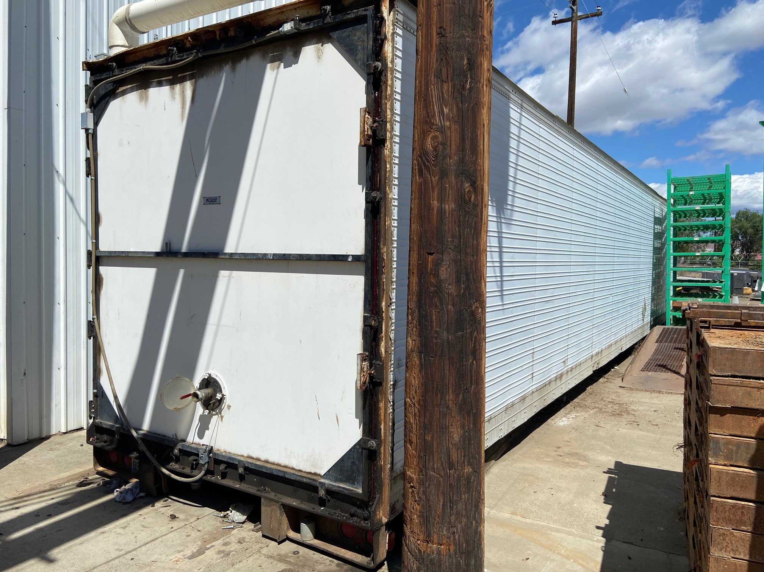
Fumigation of cherries for export with methyl bromide
Chamber certification
early in the season
Harvest
Cooling
Bins placed
in chamber/
heating
Chamber sealed &
product released (2hrs)
Entire process is certified by USDA

Slide 10
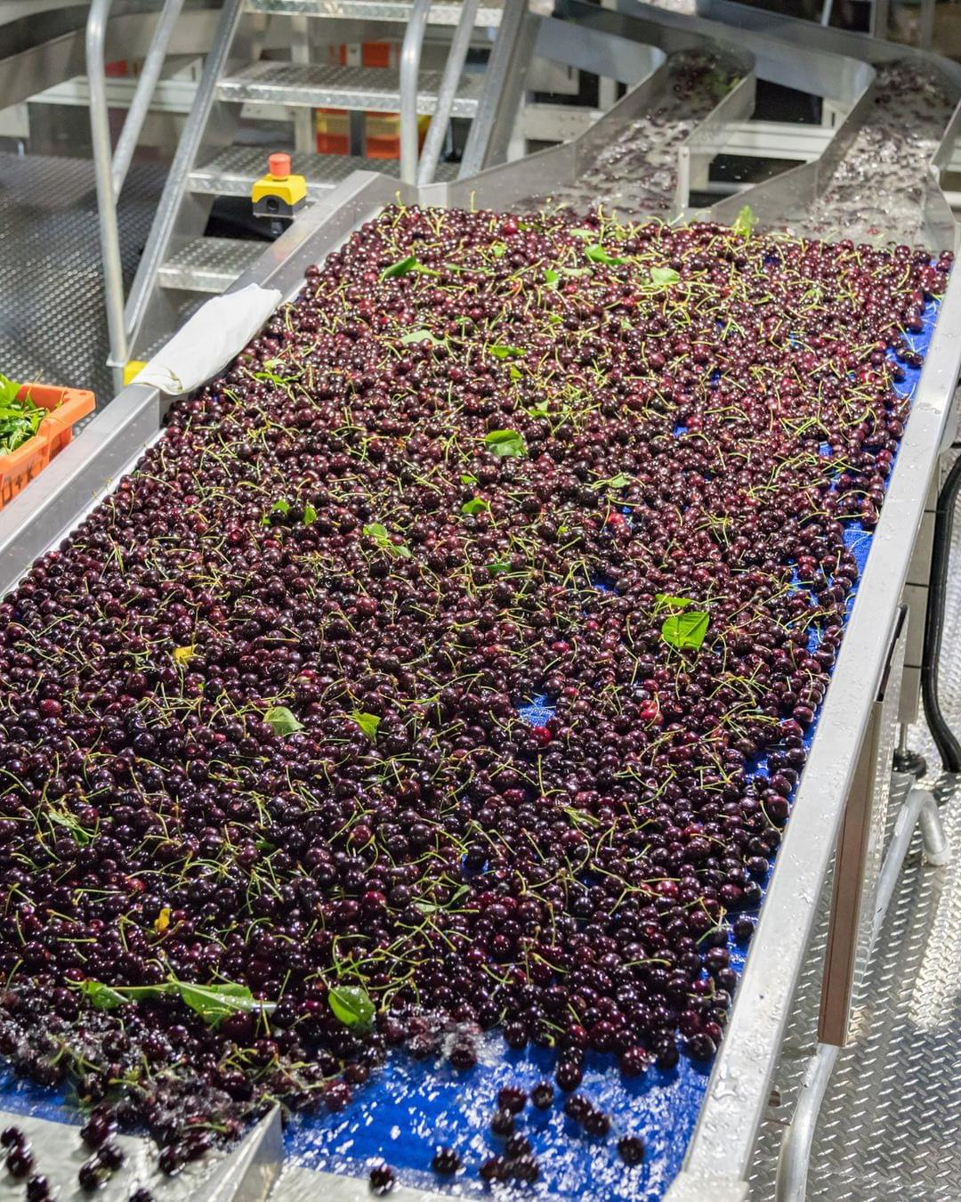
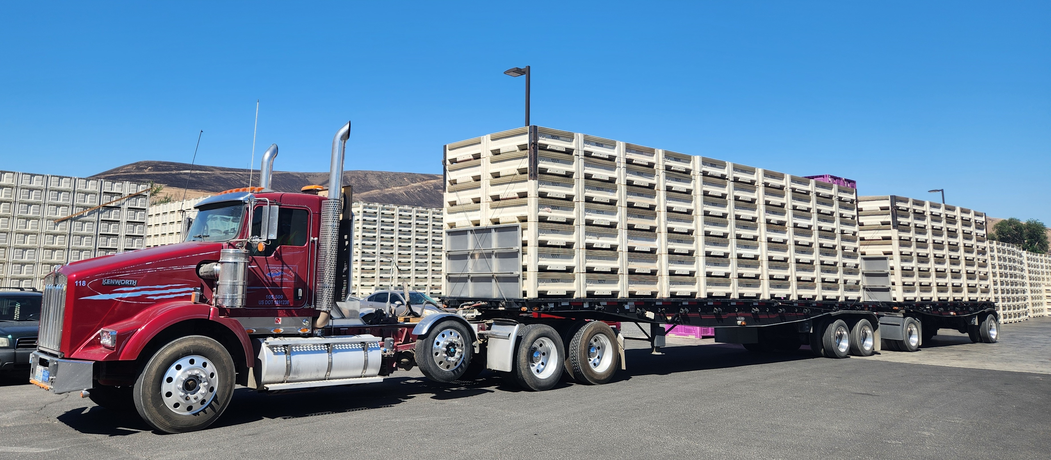
Fumigation of cherries for export with methyl bromide (cont.)
The PNW produces 18-20 million 20-pound boxes (30% are exported)
6-8 weeks
Ability to fumigate large volumes

Slide 11
Evaluating alternatives to methyl bromide
Chemical
  Other fumigants (phosphine)
Non-chemical
  Irradiation
  Heat
  Steam
  Cold
Systems approaches

Slide 12
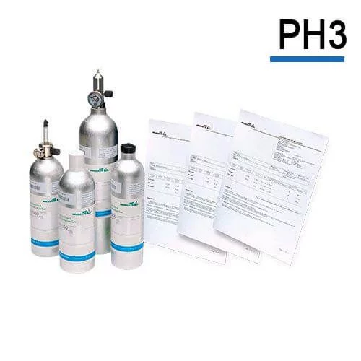
Phosphine
Colorless, highly toxic gas
Fumigant for stored grain pests
Slow acting (days in cherries)
Not registered for tree fruit
Explosive
May require expensive equipment
Not commercially available

Slide 13
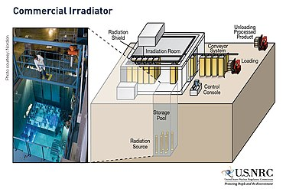
Irradiation – not viable
Ionizing radiation
Cobalt 60 or other
Slow acting
Doesn’t kill the pest (sterilized or moribund)
Can damage fruit
Not commercially available
Not accepted by many export markets
Costly

Slide 14
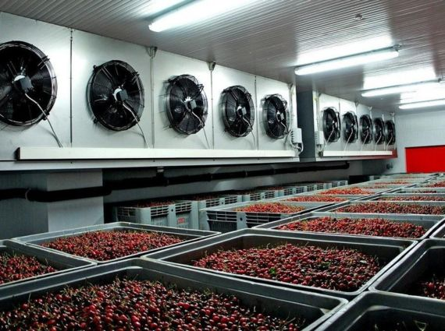
Heat/cold treatments
Steam, heat, cold or CATTs (Controlled Atmosphere Temperature Treatment System)
No chemical residues
Can affect quality of the fruit
Expensive installation
Slow process
Difficult to adjust temperature changes

Slide 15
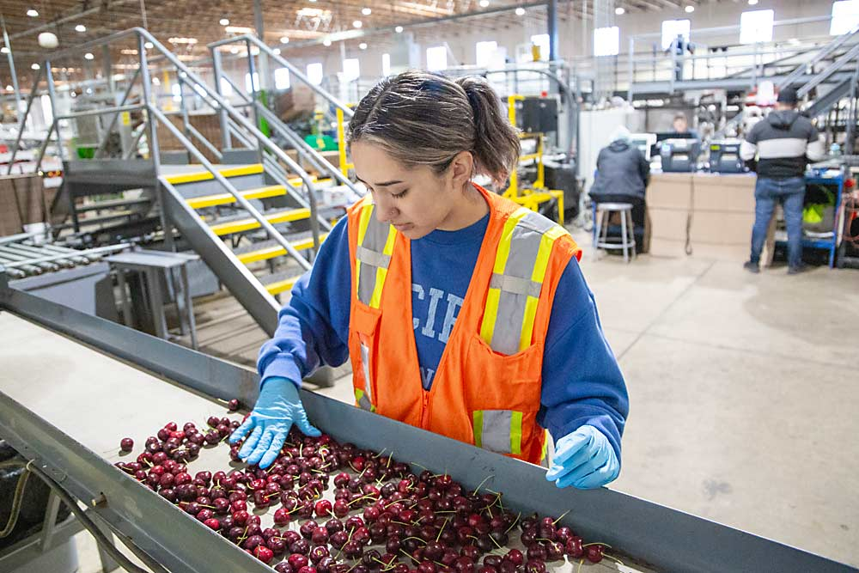
Systems approaches
Combination of phytosanitary measures
Acceptance dependent on importing countries
May include pre-and/or pos-harvest practices (orchard, packinghouse, inspection, risk management, pest surveillance and trapping, etc.)
Not established for critical export markets
Need to be developed for new products, scenarios and pests
Requires years or even decades to negotiate by national plant protection organizations (NPPOS)

Slide 16
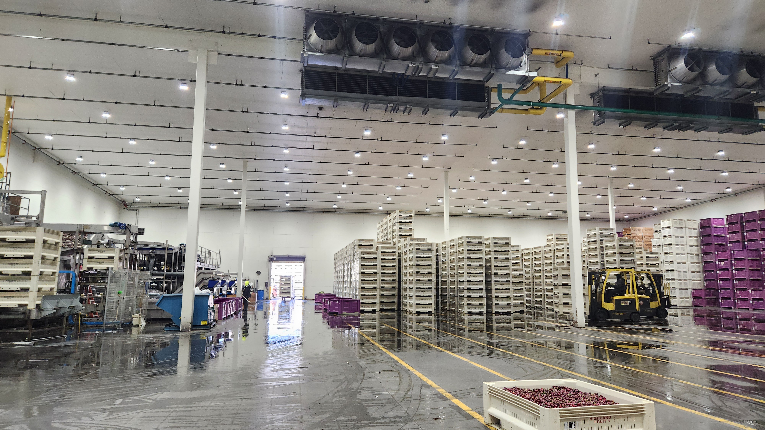
Data gaps for methyl bromide alternatives
Fruit quality
Fast acting
Effective (kill the pest)
Tested under real life scenarios (> 1 pallet, packinghouse)
Scalable, commercially viable
Cost effective
Registered and accepted by importing country

Slide 17
Impacts of loosing methyl bromide for the PNW tree fruit industry
  The economic impact of losing methyl bromide for phytosanitary quarantine use would be devastating to PNW growers.
  Without methyl bromide for phytosanitary export use, PNW growers will lose vital access to these export markets, several of which do not allow Systems Approach procedures.
  Growers would also lose potential new markets, such as Israel, that proposes methyl bromide fumigation for market access.
  No viable chemical or physical alternatives to methyl bromide that effectively control pests without affecting fruit quality.
  A range of postharvest quarantine treatments for tree fruit as alternatives to methyl bromide must be developed prior to phaseout discussions.
  Research into orchard-through-packinghouse systems approach protocols, as an alternative to methyl bromide treatment, is needed for export of tree fruit.

Slide 18

Methyl Bromide Need
On arrival application for quarantine pests - essential
Reduces export risk
Single container valued at $20,000-$30,000
Cost of rejected container $40,000-$50,000 - return
No one-for-one fumigant replacement

Slide 19
Caution Required
Other Regional PPOs will read the MB report
Don’t want to send the wrong message
Discussion of alternatives requires care
Characterization of methyl bromide requires care - benefits

Slide 20
Questions?

