Slide 1
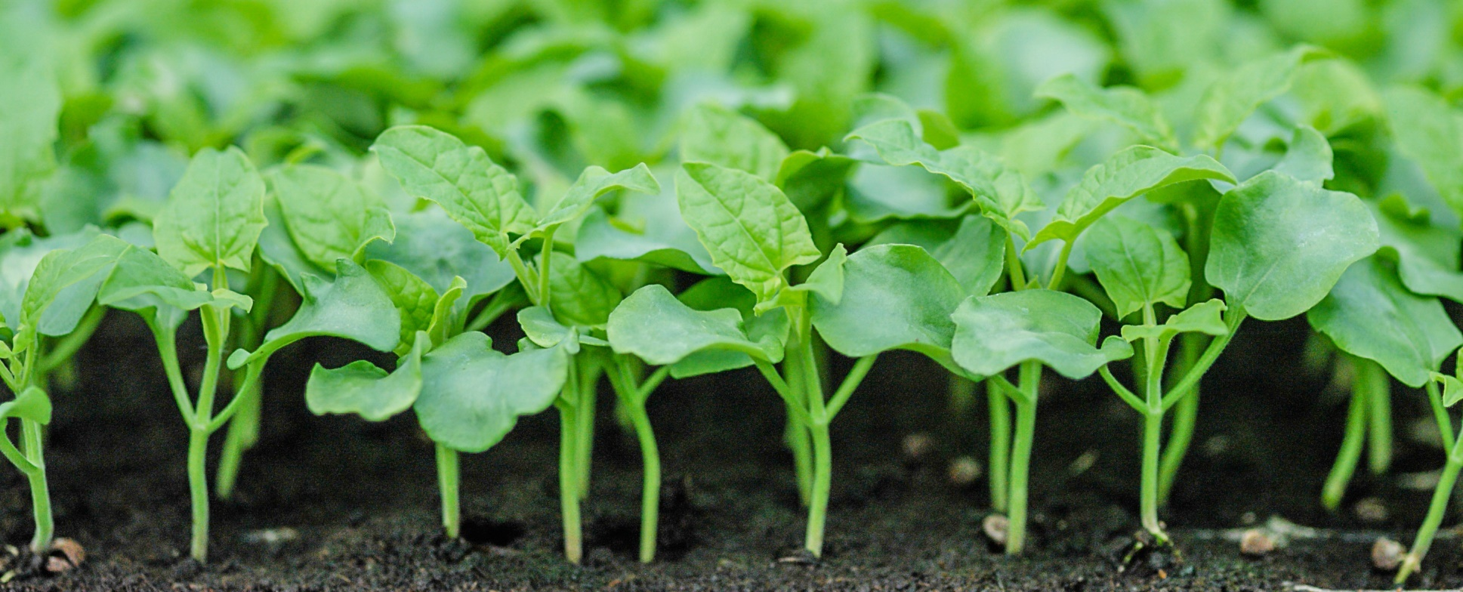
Safeguarding Agriculture, Facilitating Safe Trade
46th Annual Meeting
North American Plant Protection Organization
Dr. Mark L Davidson
Deputy Administrator
Plant Protection and Quarantine

Slide 2
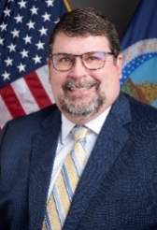
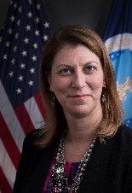
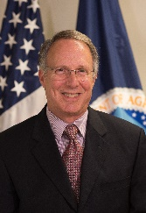
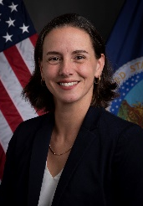
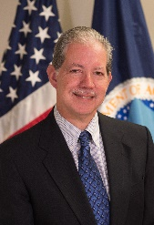
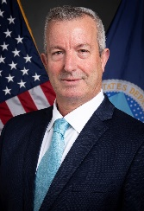
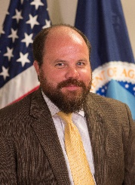
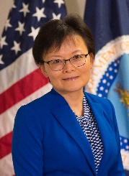
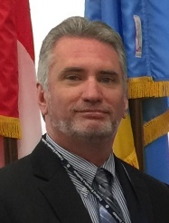
PPQ Leadership and Organizational Structure
Plant Protection and Quarantine
Mark Davidson
Deputy Administrator
Samantha Simon
Associate Deputy Administrator
Business and Employee Services
Emergency and Domestic Programs
Field Operations
Int’l Phytosanitary Management and Standards Program
Pest Exclusion and Import Programs
Science and Technology
Matt Royer Associate Deputy Administrator
Nicole Russo Associate Deputy Administrator
Carlos Martinez Associate Deputy Administrator
Ibrahim Shaqir Associate Deputy Administrator
Matt Rhoads Associate Deputy Administrator
Wendy Jin Associate Deputy Administrator
Calvin Shuler Executive Director

Slide 3
ePhyto Global Solution
U.S. is successfully sending to 94 trading partners through the IPPC Hub—and receiving from 77
APHIS is pleased with progress on finding a long-term funding solution to ensure ePhyto can be a global reality—permanently

Slide 4
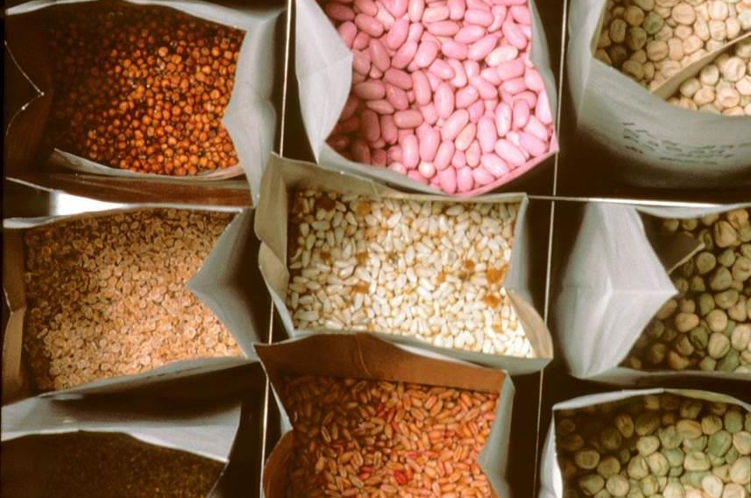
Seed Health and ReFreSH
Will result in a more effective and efficient program for managing risk associated with international seed movements
Carefully considered stakeholder input on the Accreditation Standard and Participant Manual, then posted final versions
Continuing our ReFreSH pilot with Chile to exchange small lots of seed

Slide 5
Sea Container Cleanliness
Participated in the IPPC sea container workshop in Brisbane, Australia
Attendees reviewed the draft IPPC sea container recommendations
Looking forward to supporting adoption of the updated IPPC recommendation on sea containers at the IPPC Commission meeting in April 2024

Slide 6
One Health
The health of animals, people, and the environment is connected.
Plants are a foundational part of environmental health, and food security is essential to human health.
That security requires crops that are protected against invasive pests.
APHIS is drafting a One Health document that emphasizes the plant side more.

Slide 7
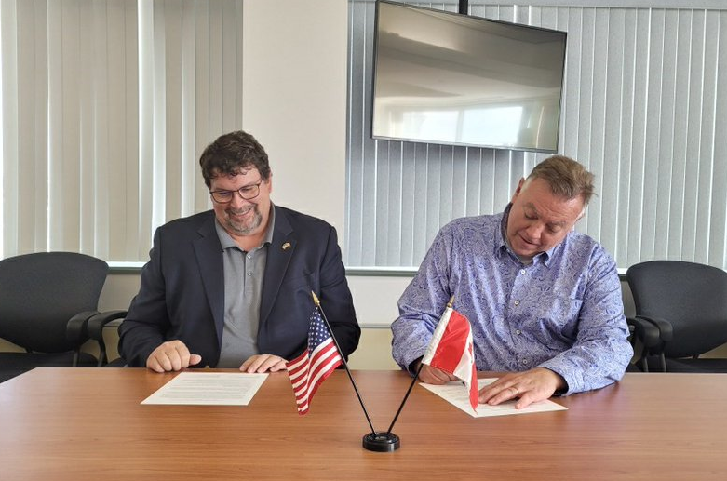
U.S.-Canada Coordinated Phytosanitary Mitigation Framework
Finalized an action plan that will enhance our coordination, collaboration, and communication
In addition, partnered with the NPB, CFIA and Canadian provinces, working to ensure a timely & harmonized response to pest introductions and spread

Slide 8
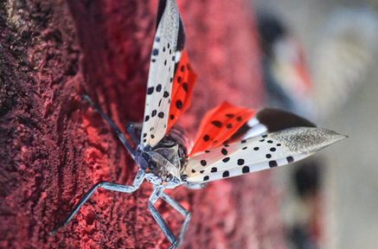
Goal 1: Effectively limit the advancement of SLF and efficiently respond to its introduction within Federal and State authority and resource availability
Goal 2: Support continued scientific research towards practical management and risk mitigation
Goal 3: Establish a consistent national- and State-level outreach message and educational campaign for the public and industries at risk for dispersal of spotted lanternfly
Spotted Lanternfly 5-Year Strategy

Slide 9
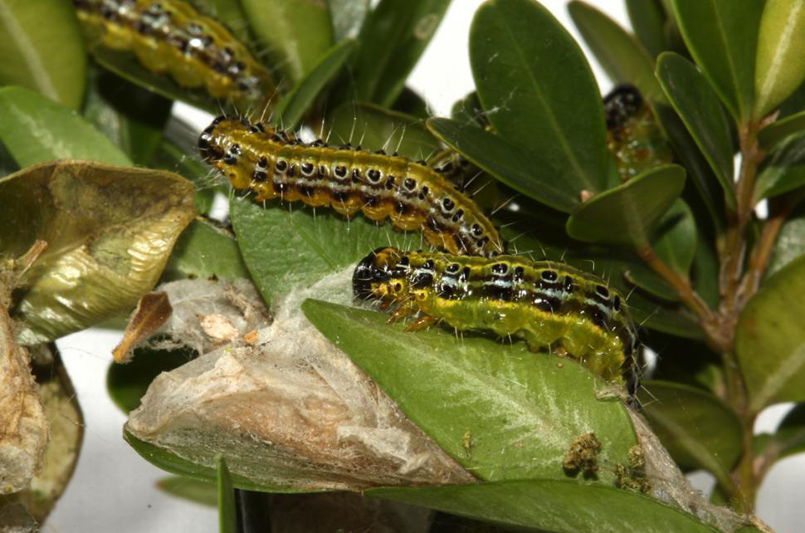
Box Tree Moth (BTM)
BTM feeds on and kills boxwoods, found in NY, MA, MI, and OH: State-Federal responses in progress
Collaborating with stakeholders to develop a systems approach and management practices for safe boxwood movement
Remain focused on limiting BTM’s spread and protecting as many States and boxwoods as possible

Slide 10
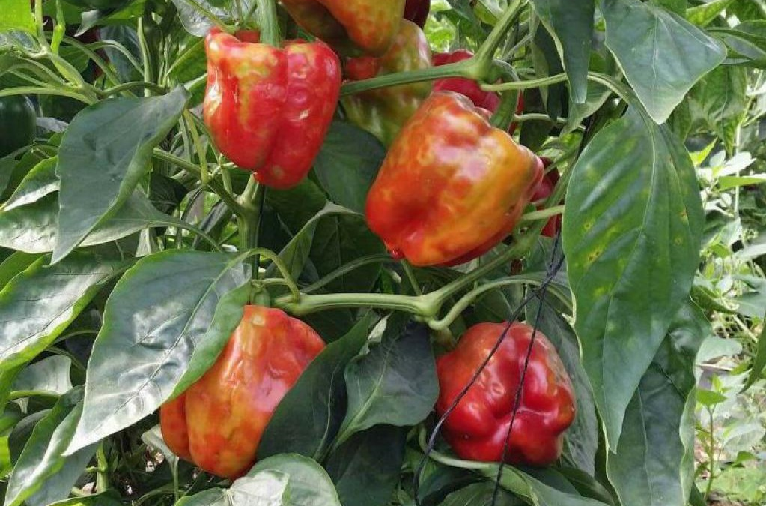
Tomato Brown Rugose Fruit Virus
3 Regulatory Options:
1. Continue to regulate the virus as a quarantine pest, but remove the import restrictions for tomato and pepper fruit for consumption.
2. Categorize the virus as a non-quarantine pest and rescind the import Federal Order.
3. Continue to regulate the virus as a quarantine pest and implement the requirements in the existing import Federal Order without change.

Slide 11
Thank you!
46th Annual Meeting
North American Plant Protection Organization
Dr. Mark L Davidson
Deputy Administrator
Plant Protection and Quarantine

