Slide 1
The National Plant Diagnostic Network
NAPPO Meeting 2023
Merida, Mexico
Neil McRoberts

Slide 2
Who are we?
Established by USDA in 2002 in response to crop biosecurity concerns post-9/11
Built on existing land-grant-university extension system: plant diagnostic labs in every state and most territories
To enhance health and productivity of plants in agricultural and natural ecosystems in the United States by providing high quality diagnostic services and efficient communication.
Emphasis is on plant disease, also includes expertise in entomology, nematology, and weed science

Slide 3
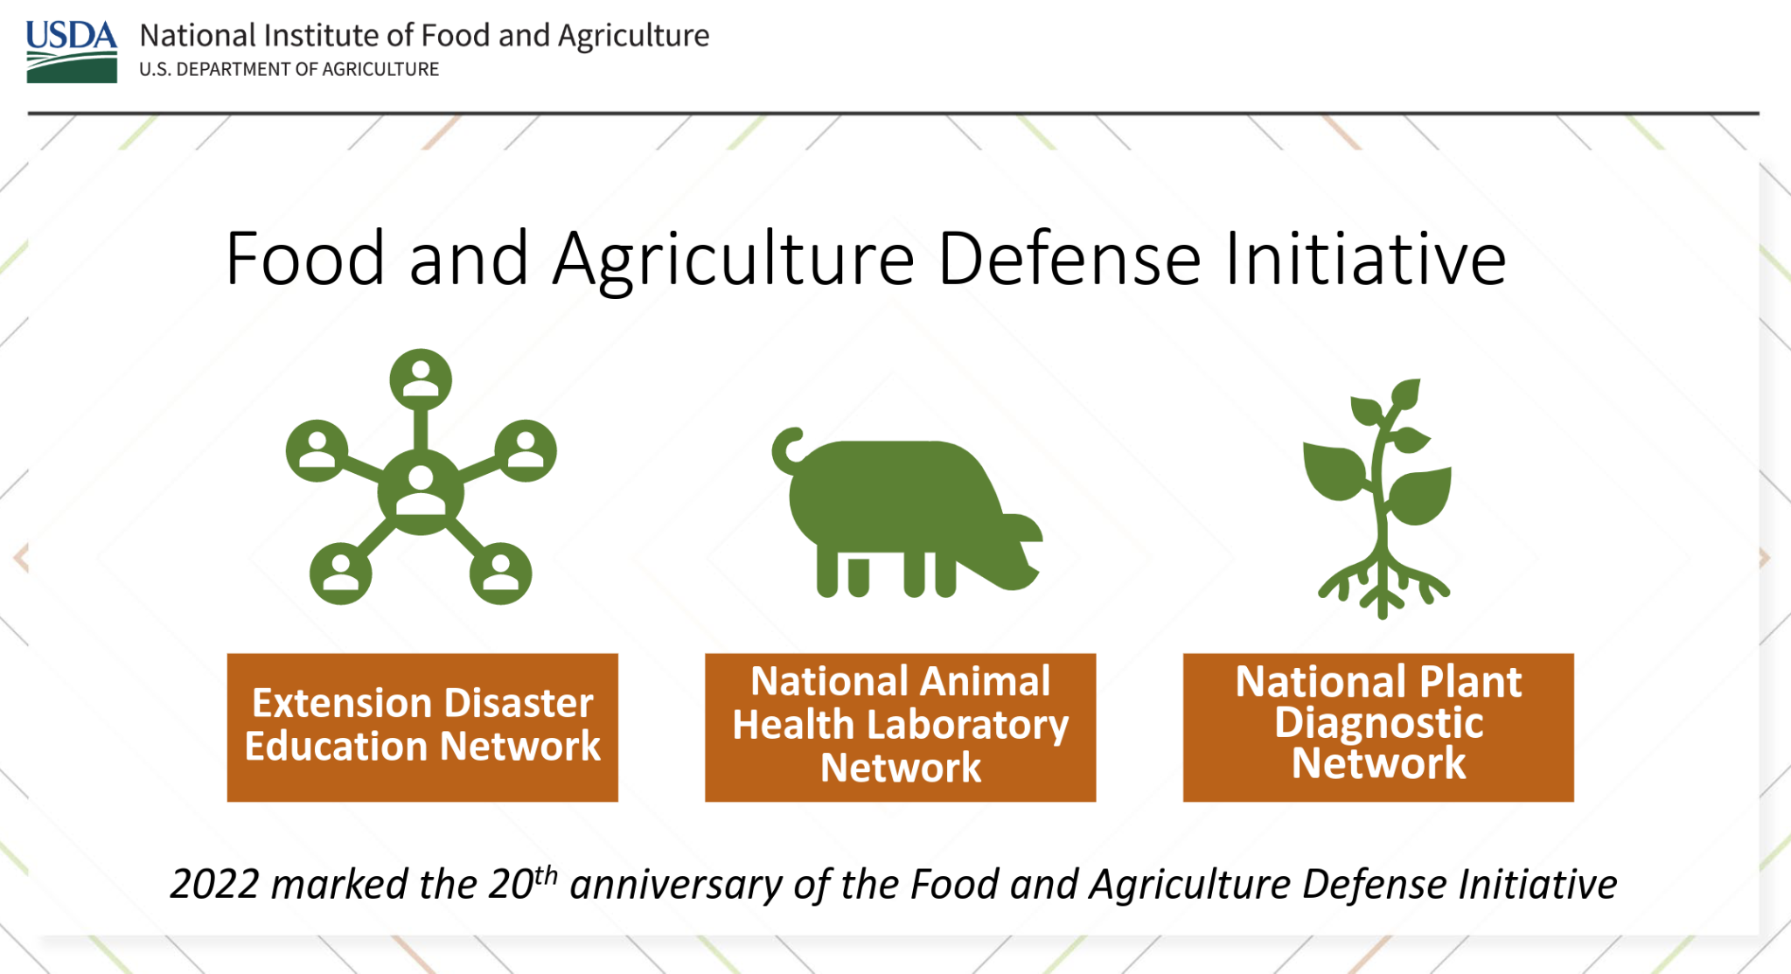
NPDN is one of the Tactical Sciences programs in USDA-NIFA

Slide 4
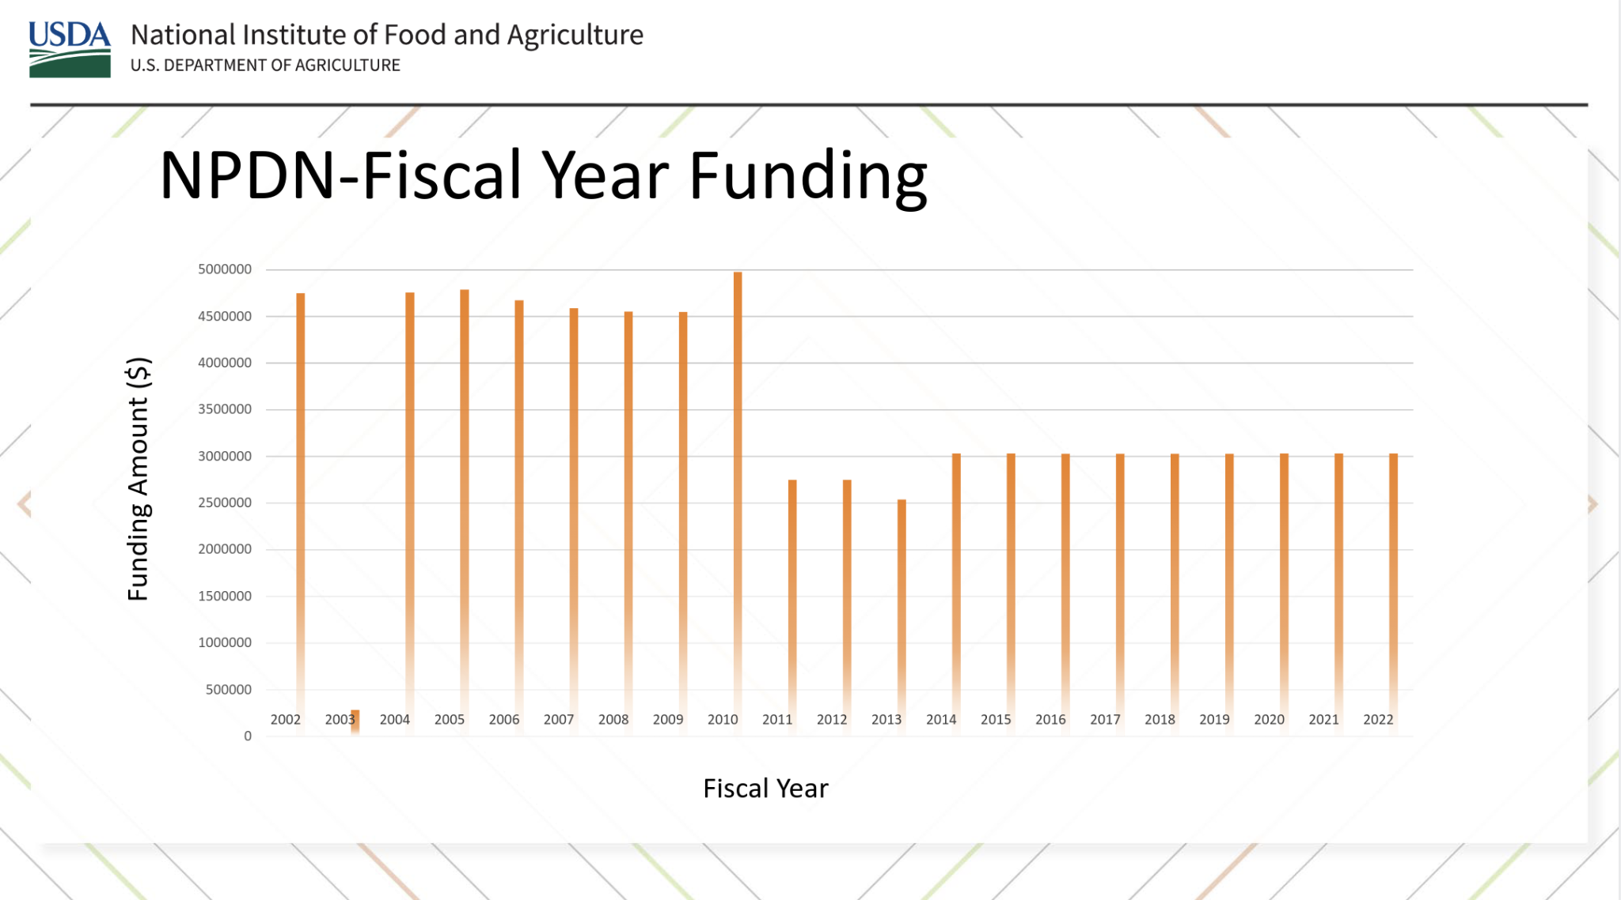
NPDN Budget history

Slide 5
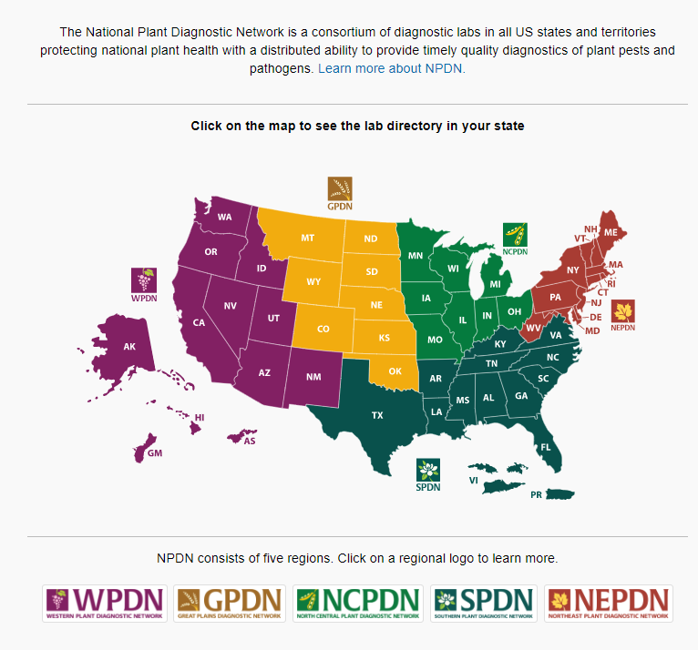
Who are we?
Cooperative agreements between USDA-NIFA and Regional Centers
Five regions and an IT and data center
Cooperative agreements between Regional Centers and labs in each state
Partner labs in all states: regulatory, extension, research, industry

Slide 6
What we do
Surge support – distributed lab capacity
Sample referral – distributed expertise
Passive surveillance – sentinel labs in each state
Quality diagnostics – Professional development, accreditation, proficiency, protocols.
Emphasis on connections and collaboration – facilitate communication

Slide 7
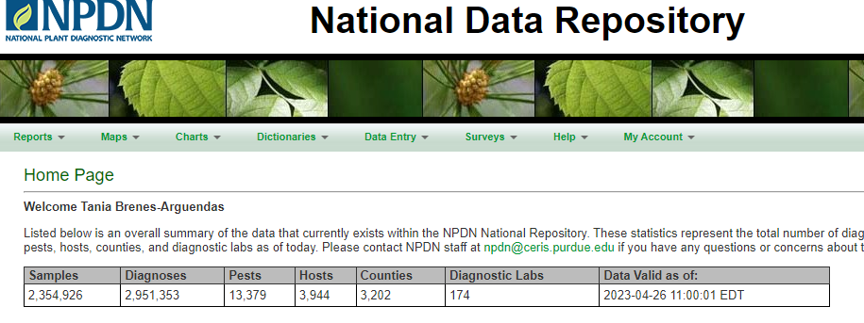
Surveillance
Labs in every state and territory
Passive surveillance
National Data Repository (NDR) receives diagnostic data nationwide
Standardized data format
  pest, host, county, method of determination, confidence level (confirmed/not detected/suspected)
Role-based security access

Slide 8
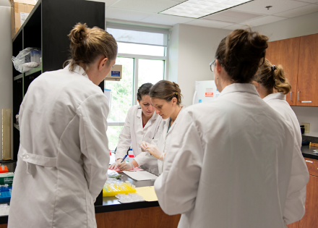
Collaboration
Within US
  NPB (local services, surveillance, response)
  APHIS (surveillance, confirmation)
  USDA-ARS (protocols)
  IPM (outreach)
  NPDN (local clientele, new detections)
Challenges
  Trade implications
  Staff turnover
Solutions
  Confidentiality
  Lots of conversation with lots of partners

Slide 9
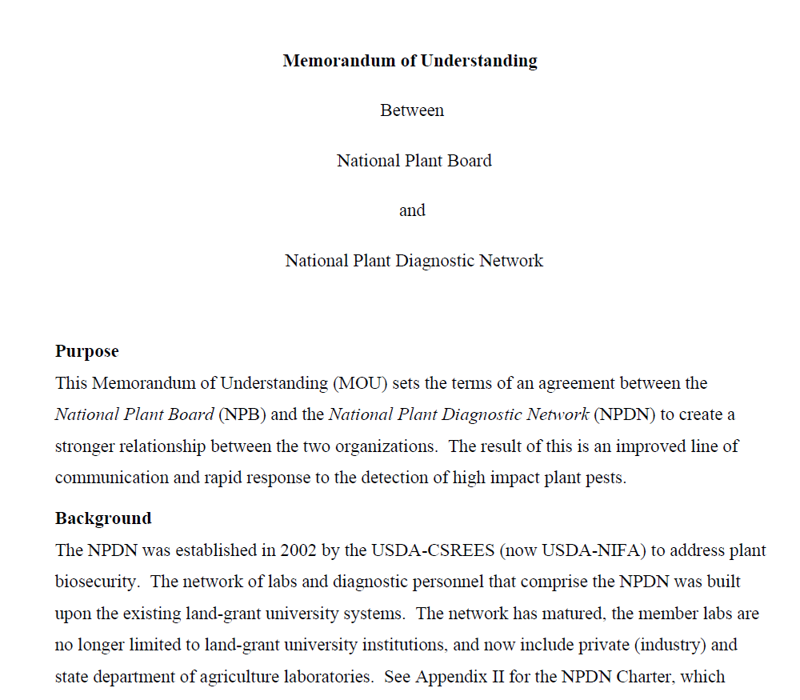
Collaboration
NPB-NPDN MOU signed 2022
Strengthen relationships at the state level
Brian Kuhn, Julie VanMeter, Steven Long, and the NPDN Regulatory Relations Committee
Roles and responsibilities
Commitment to joint educational activities
Data access

Slide 10
Data access: the fine print
State-level access: data for samples that originated from your state (occasionally diagnosed in a different state)
No sharing (see data use policy) (sharing is separate data request each instance)
Data: limited number of fields: state, county, host, pest, method, diagnostic confidence (confirmed/not detected/etc.). No grower info, rarely GPS, no incidence/severity. (ask your diagnostician)
Absence of evidence is not evidence of absence
Diagnostic data are very different from survey data (passive surveillance)
Questions about diagnoses should always be with the lab who did the diagnosis.
Daily NDR first report emails - state-level only
  First report ≠ first detections; just first in the NDR

Slide 11
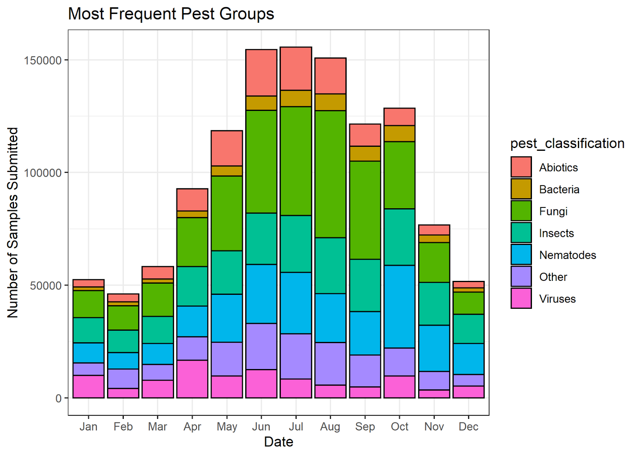
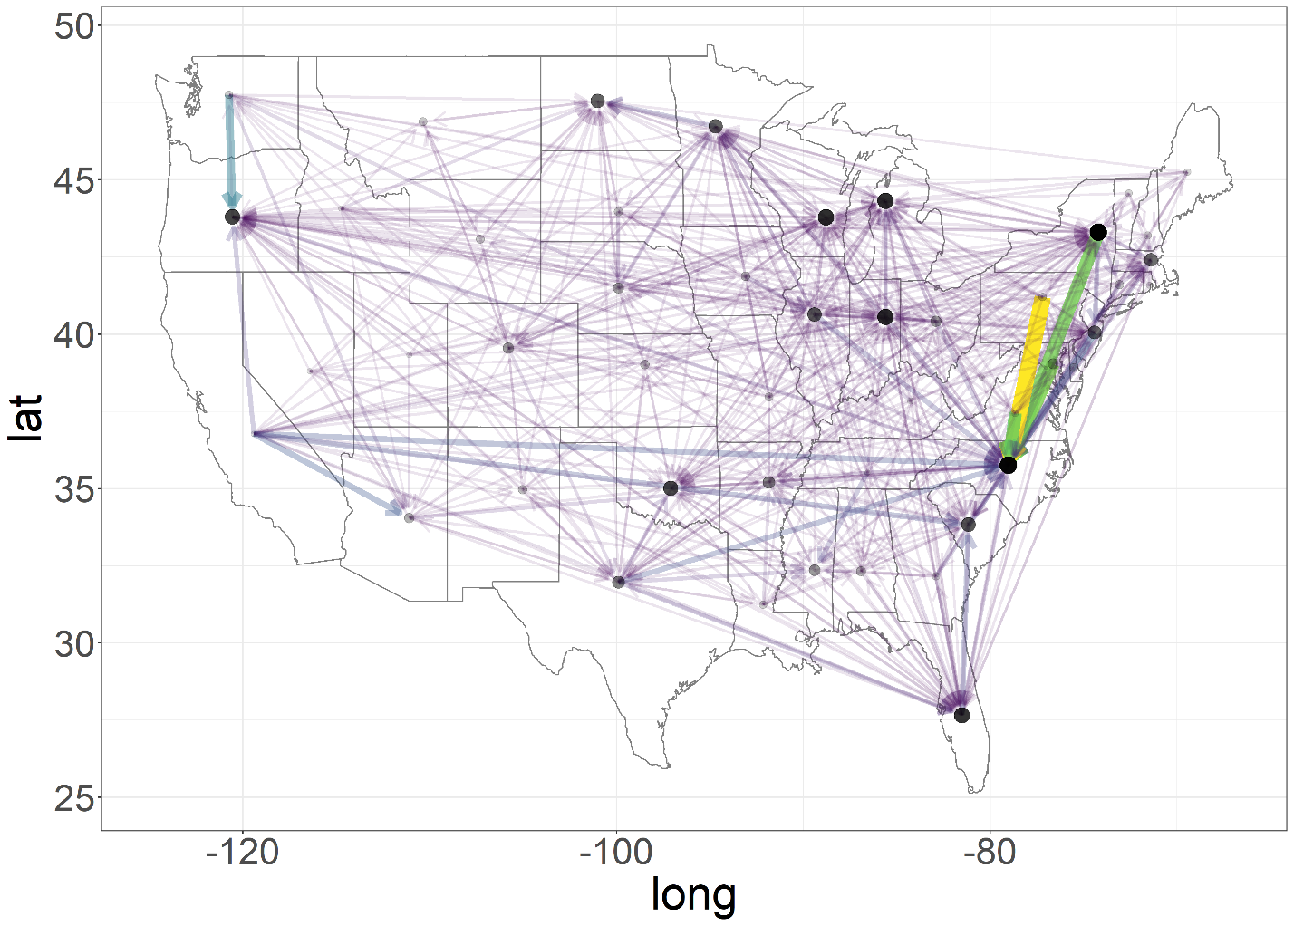
Network analysis (PPA7721)
Between January 1st, 2010 and December 31st, 2019, approximately 1.73 million records of samples processed by NPDN, 12.5% of all samples, moved between states for diagnostic determination.
In spite of having no capacity for active surveillance, NPDN has received samples from >90% of counties in continental USA
Notes:
Summary # of samples of major (>5%) pest classes submitted and processed by NPDN labs between 2010-2019, grouped by month

Slide 12
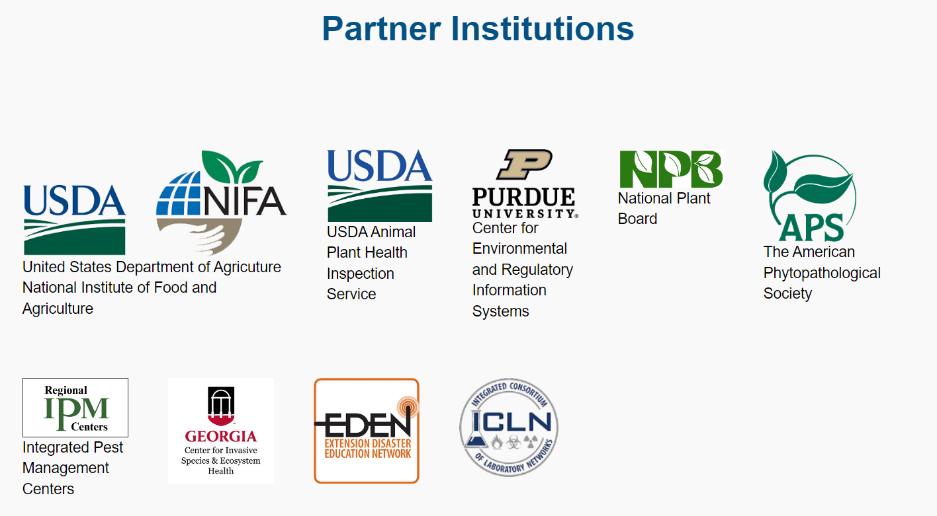
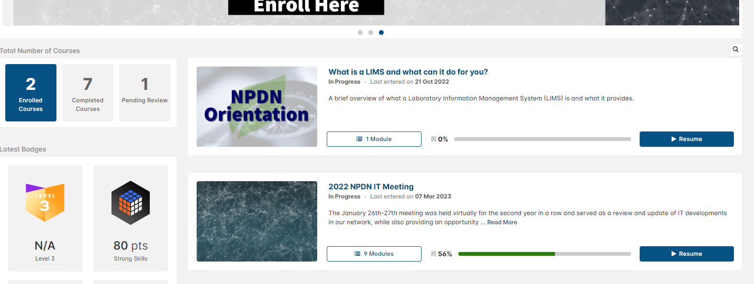
How do we do it?
Leveraging funding
Partnerships
Npdn.org
Professional Development Online and in Person
National Data Repository
Accreditation

Slide 13
Collaboration
Challenges
  Personnel turnover
  Data interpretation
  New technology (equipment, methods)
  Updating goals (epidemiology)
Solutions
  NPB-NPDN MOU
  New technology (training, LIMS)
  Professional Development committee
  Data Use and Policy committee

