Slide 1
Boll Weevil Eradication Program (BWEP) Progress between 2016 - 2023
Matthew Aubuchon
USDA-APHIS-PPQ
Emergency and Domestic Programs
Cotton Pest Programs
National Policy Manager
46th NAPPO Annual Meeting, December 6, 2023
Notes:
Greetings everyone. My name is Matthew Aubuchon and I am the National Policy Manager for Cotton Programs, which include the Boll Weevil Eradication Program.
I would like to summarize NAPPO’s role in the binational Boll Weevil Eradication Program between the United States and Mexico between 2016 to the present day.

Slide 2
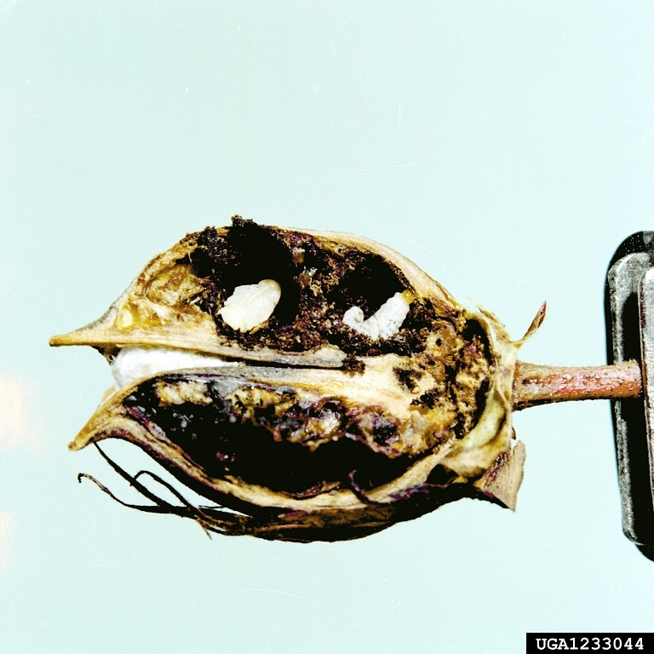
Boll Weevil Eradication Program Background
Since the 1970s, both the U.S. and Mexico initiated national programs with the clear objective of eradicating the Boll Weevil (BW) from commercial cotton produced from both countries.
The BW caused extensive crop damage and incurred significant treatment costs to growers attempting to control BW.
By 2015, the BW was pushed down to the Lower Rio Grande Valley (LRGV), Texas in the United States, and Northern Tamaulipas in Mexico.
Boll Weevil (Anthonomus grandis) on cotton (Gossypium hirsutum)
Clemson University – USDA Cooperative Extension Slide Series: Bugwood.org
Notes:
Since the 1970s, both the US and Mexico initiated national programs with the clear objective of eradicating the BW from commercial cotton produced from both countries.
The BW caused extensive crop damage and incurred significant treatment costs to growers attempting to control BW.
By 2015, the BW was pushed down to the LRGV, Texas, and the state of Northern Tamaulipas in Mexico.

Slide 3
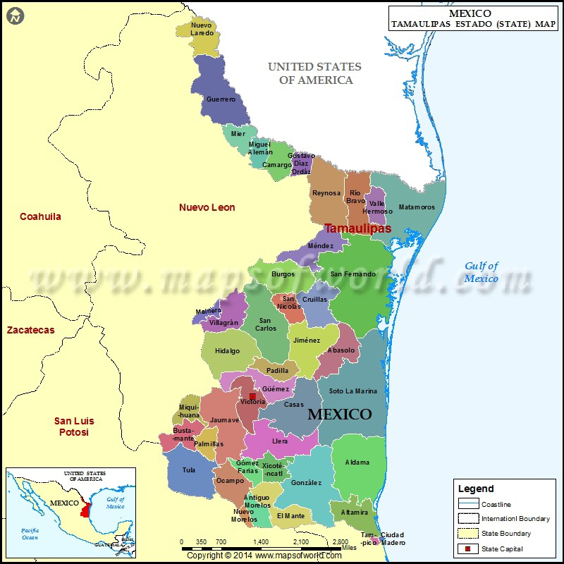
United States of America
LRGV
Boll Weevil Eradication Program Locations
Growers in LRGV, Texas, plant ~73,000 hectares of cotton annually.
Growers in Tamaulipas, Mexico, plant between 8,000 – 11,000 hectares of cotton annually.
Growers in both countries confront the same environmental conditions
BW pressure in one country can easily move over the border
Notes:
This map illustrates the geographic proximity of cotton-growing areas in LRGV and Tamaulipas where two national BW eradication programs meet.
Growers in LRGV, Texas, plant ~73,000 hectares of cotton each year
Growers in Tamaulipas, Mexico, plant between 8,000 – 11,000 hectares of cotton each year
Growers in both countries confront the same environmental conditions
BW pressure in one country can easily move over the border

Slide 4
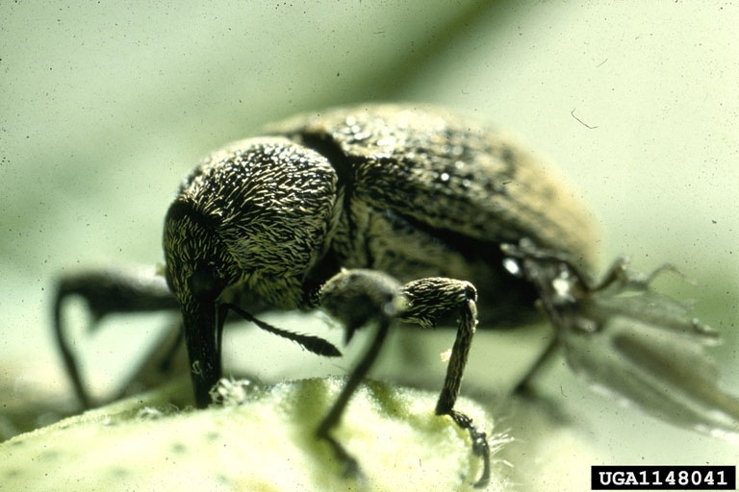
Boll Weevil Eradication Program Background
By 2015 eradication efforts in Tamaulipas stalled:
Lack of a coordinated operational plan between United States and Mexico
Delays in funding or availability of Malathion by end of the season, when BW activity peaks
Delayed payments to aerial applicators resulting in treatment delays
Setbacks from erratic storm systems interfering with BW trapping and treatments in both the U.S. and Mexico
Challenges in Tamaulipas prolong BW eradication in both Mexico and the United States.
USDA APHIS PPQ - Oxford, North Carolina , USDA APHIS PPQ, Bugwood.org
Notes:
By 2015, eradication efforts in Tamaulipas stalled due the following challenges:
Lack of coordinated operational plan between United States and Mexico
Delays in funding or availability of Malathion by end of the season, when BW activity peaks
Delayed payments to aerial applicators in Tamaulipas causing treatment delays when BW activity was detected
Setbacks from erratic storm systems interfering with BW trapping and treatments
Challenges in Tamaulipas prolong BW eradication in both the United States and Mexico, adding costs to the program. As long as there is BW activity in Tamaulipas and LRGV, there is the threat that it may reinfest areas where it was previously eradicated.

Slide 5
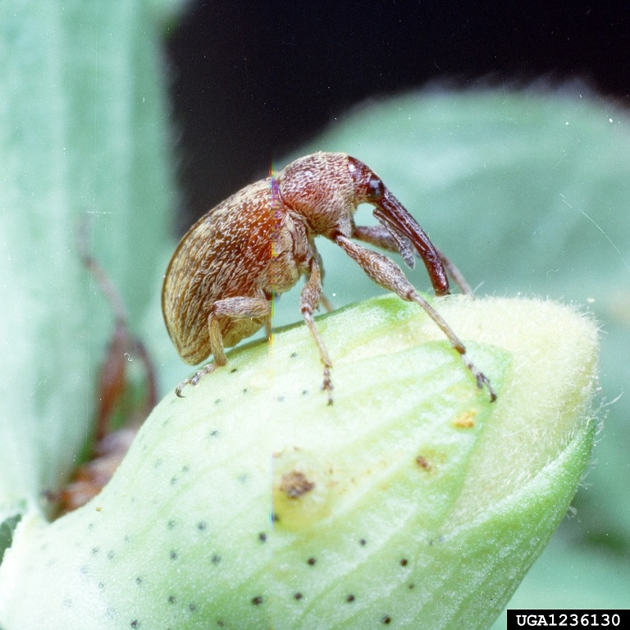
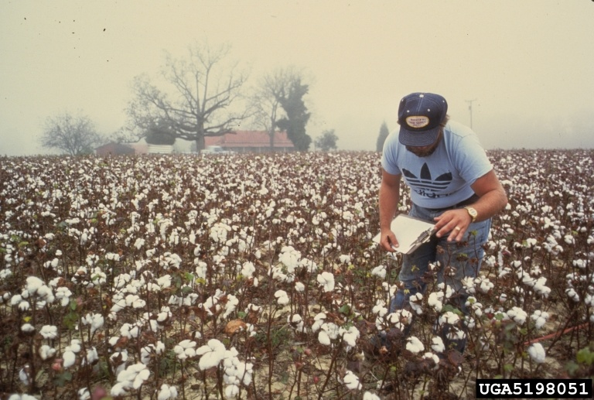
NAPPO’s Role in the Boll Weevil Eradication Program
In 2016, APHIS-PPQ established a Cooperative Agreement with NAPPO to facilitate supplies and payments for eradication efforts in Tamaulipas.
APHIS provides between $3M - $4M into the agreement annually.
NAPPO’s Strategic Goal 1:
“To protect North American plant resources from the introduction and spread of regulated plant pests.”
Boll Weevil (Anthonomus grandis) on cotton (Gossypium hirsutum)
Clemson University - USDA Cooperative Extension Slide Series , , Bugwood.org
Florida Division of Plant Industry: FDACS: Bugwood.org
Notes:
APHIS-PPQ established a Cooperative Agreement with NAPPO in 2016 to address some challenges facing the BW Eradication Program in Tamaulipas.
APHIS fund between $3M - $4.1M annually towards the agreement, depending upon BW pressure, environmental conditions, and rising costs of Malathion.
This agreement aligns with NAPPO’s Strategic Goal 1: “To protect North American plant resources from the introduction and spread of regulated plant pests.”

Slide 6
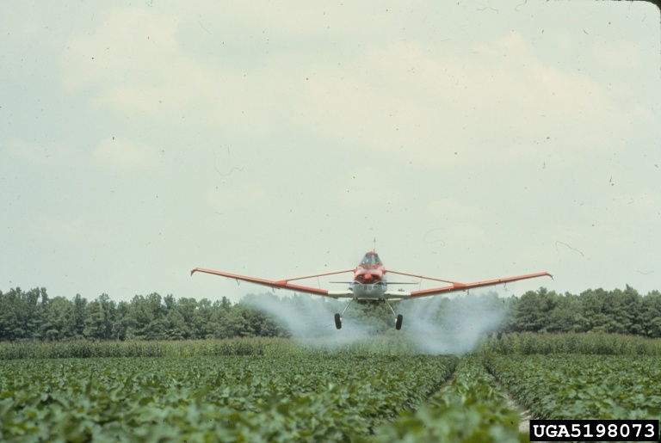
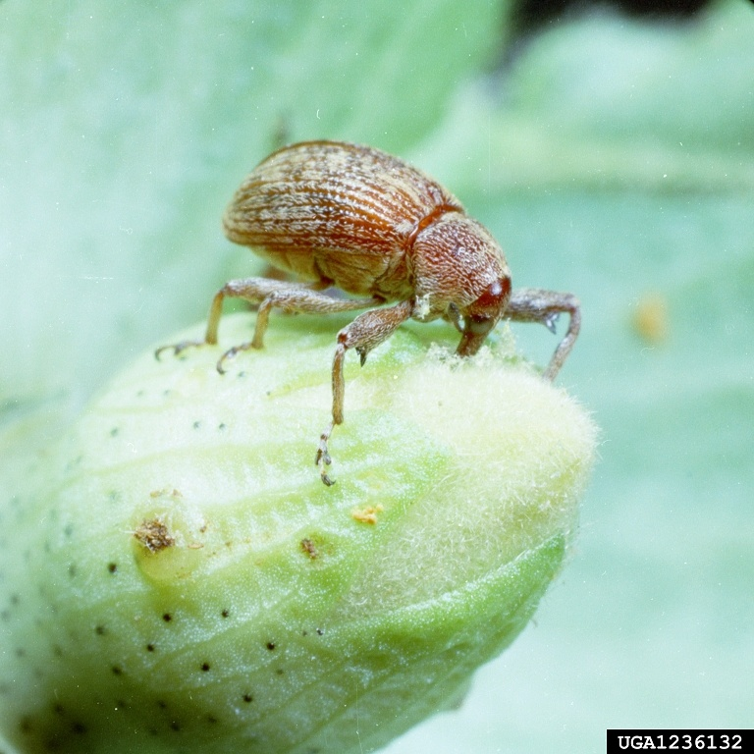
NAPPO’s Role in the Boll Weevil Eradication Program (continued)
Boll Weevil (Anthonomus grandis) on cotton (Gossypium hirsutum)
NAPPO’s activities include:
Managing program funds
Processing certified payment requests
Sending timely payments for program expenses
Directly to Malathion supplier
Directly to aerial applicators
Providing account updates to APHIS-PPQ
Maintaining records for all deposits and expenditures
Preparing annual financial report
Scheduling the yearly Program Specific Audit
Florida Division of Plant Industry: FDACS: Bugwood.org
Clemson University - USDA Cooperative Extension Slide Series , , Bugwood.org
Notes:
NAPPO’s activities include:
Managing program funds
Processing certified payment requests
Sending timely payments for program expenses
Directly to Malathion supplier
Directly to aerial applicators
Providing account updates to APHIS-PPQ
Maintaining records for all deposits and expenditures
Preparing annual financial report
Scheduling the yearly Program Specific Audit

Slide 7
Program Accomplishments and
Results 2016 - 2022
YEAR | Total BW Captures in Tamaulipas
2016 | 60,935
2017 | 26,982
2018 | 56,666
2019 | 7,396
2020 | 29,894
2021 | 11,143
2022 | 407
2023 | 1974*
NAPPO’s involvement with the eradication program has yielded over 90% reduction in BW captures in Tamaulipas between 2016 and 2022.
Adequate and stable supplies of Malathion are available throughout the growing season.
Professional pilots deliver timely applications of Malathion over fields where BW activity is found.
By October 23, 2023, there were 407 BW captures.
*Final 2023 BW data will be available in December.
Notes:
NAPPO’s involvement with the eradication program has yielded an 90% reduction in BW captures in Tamaulipas between 2016 and 2022
Adequate and stable supplies of Malathion are available throughout the growing season.
Professional pilots deliver timely applications of Malathion over fields where BW activity is found
By October 23, 2023, there were 1974 BW captures.
Final 2023 capture data will be available in December

Slide 8
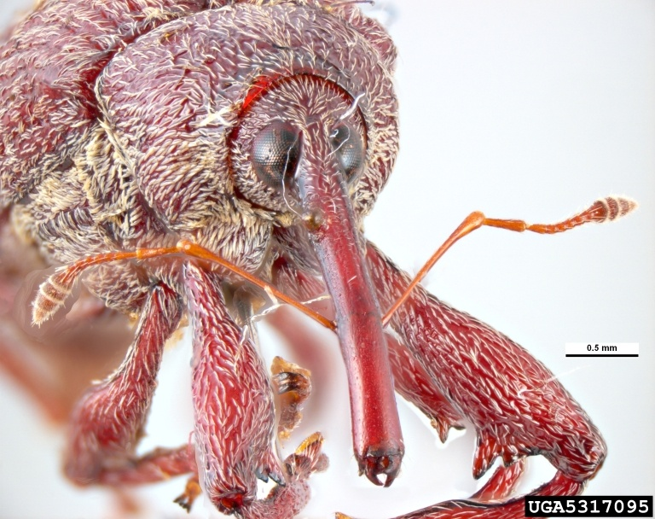
Program Benefits and Closing Remarks
Boll Weevil (Anthonomus grandis)
Pest & Disease Image Library: Bugwood.org
Benefits
Cotton industry and growers in the United States and Mexico.
Closing Remarks
APHIS-PPQ continues to meet with Texas Boll Weevil Eradication Foundation and Mexico’s Federal Plant Protection Agency (SENASICA) to monitor progress on BW eradication efforts in Tamaulipas and the LRGV.
APHIS-PPQ will continue to provide funds towards the NAPPO Cooperative Agreement to facilitate BW eradication efforts in Tamaulipas.
Notes:
Benefits
Cotton industry and growers in United States and Mexico
Closing Remarks
APHIS-PPQ will continue to provide funds towards the Agreement with NAPPO to facilitate eradication efforts in Tamaulipas.
APHIS-PPQ continues to meet with Texas Boll Weevil Eradication Foundation and Mexico’s Federal Plant Protection Agency (SENASICA) to monitor progress

