Slide 1

ePhyto progress
December 2023

Slide 2
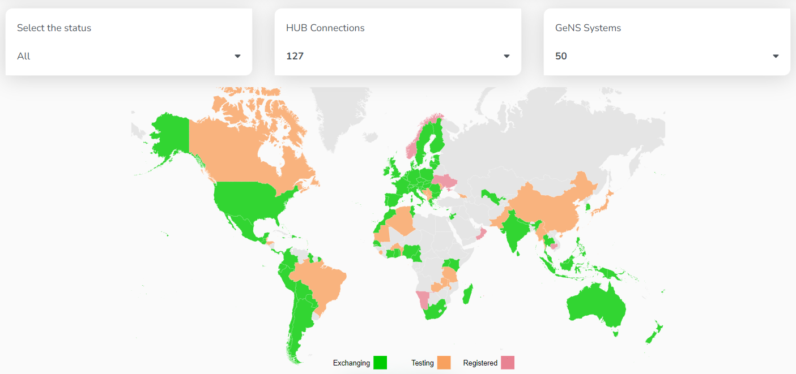

Slide 3
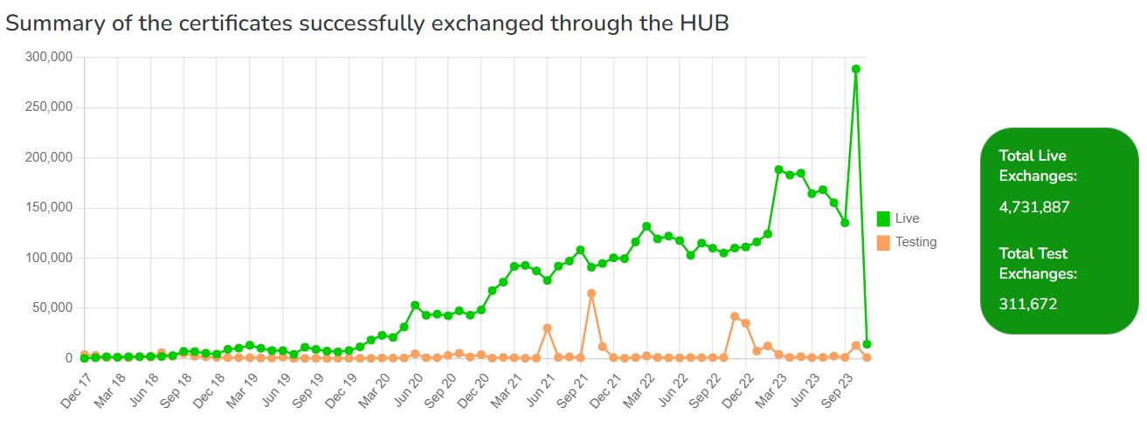
Hub Infographics
https://www.ephytoexchange.org/landing/hub/index.html

Slide 4
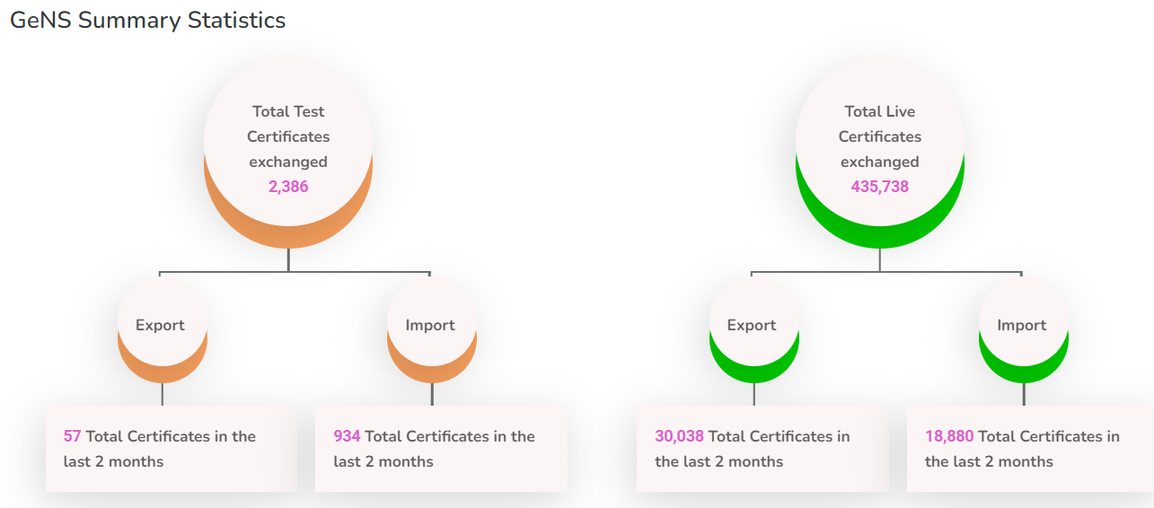
GeNS Infographics
https://www.ephytoexchange.org/landing/gens/index.html

Slide 5
Ongoing Activities
  CPM Focus Group on Sustainable Funding for ePhyto
  Translation into other languages (GeNS)
    French, Arabic (live)
    Spanish (in progress)
  Routine maintenance and enhancements
  Continued collaboration with non-phytosanitary agencies/organizations (OIE/Codex/Others)
    NPPO workshops with the ePhyto Industry Advisory Group (IAG)
    Ongoing projects with the Global Alliance for Trade Facilitation
  Linkage to other government systems (Single Windows, Customs, ASYCUDA, Industry, etc.)
  Training for GeNS countries
  Support for countries with own systems
  Monthly ESG meetings

Slide 6

2023 NAPPO Expert Group Members
Cara Grant, CFIA
Anna Birmingham, CFIA
Industry Members:
Paul Newman , Canada Wood
Chuck Dentelbeck, Canadian Lumber Standards Accreditation Board (CLSAB)
Christian Dellis, USDA- APHIS (Chairperson)
Michael Perry, USDA-APHIS
Delfino Hernández, SENASICA
Francisca de la Cruz Martínez, SENASICA
Edgar Reyes Oregón, SENASICA
Notes:
8 NPPO Members and 2 Industry members 3 from each NPPO.

Slide 7
ePhyto progress NAPPO
Expert Group meetings
Collaborate and troubleshoot between the NPPOs
Share information on unique scenarios (territories, re-export, etc)
Participate in regional meetings and industry workshops

Slide 8
Electronic Phytosanitary Certification
Canada’s update on e-Phyto 2023

Slide 9



The CFIA plans to start sending e-Phytos to the United States in early 2024
To begin, a limited number of Canadian exporters will be invited to use My CFIA to request e-Phytos for the United States
Over time, additional Canadian exporters will be able to request e-Phytos for the United States through My CFIA

Slide 10


Electronic Phytsanitary Certification
2023 Mexico update

Slide 11

Mexico’s update on the ePhyto exchange
Countries and date:
Chile, Colombia, and Peru.
Countries and dates:
USA, April 2021
Guatemala, May 2022
Expectations for 2024
Finalize Exchange with OIRSA countries
Explore Exchange with Asia.
Costa Rica, August 2023.
Start Exchange with European Union countries and Canada
Panama, Dominican Republic, Ecuador, and Belize, December 2023
August 2019.
Exchange of Electronic Phytosanitary Certificates

Slide 12



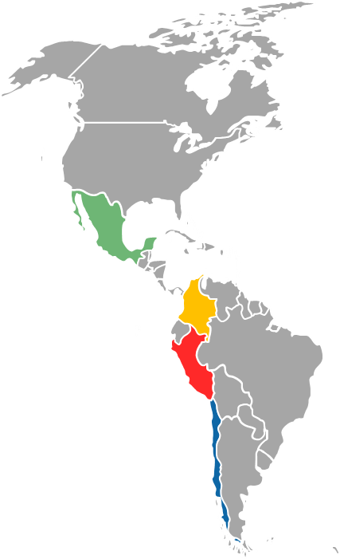

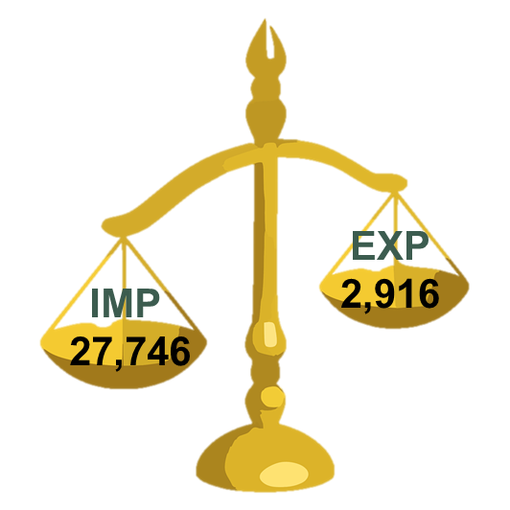

Statistics of electronic certification Exchange in Mexico
With USA
With Chile, Colombia, and Peru
67,072 Folios
Imports
Exports
With Guatemala
778 Folios
With Costa Rica
34 Folios

Slide 13




ePhyto México
Lessons learned with respect to how the electronic exchange works:
  Direct coordination and communication between the IT and operational teams of each country.
  Strengthen the use of electronic systems (emails, cell phones, whatsapp, teams, etc.) to keep constant communication between trade partners: Importers, exporters, decisión-making officers in each country.
  Clear and well-defined contingency plans for both parties involved (Example: review in each country’s websites, use of paper in case of emergencies, etc…).
  Strengthen the implementation of International Standards to facilitate other types of transactions (Animal products).

Slide 14
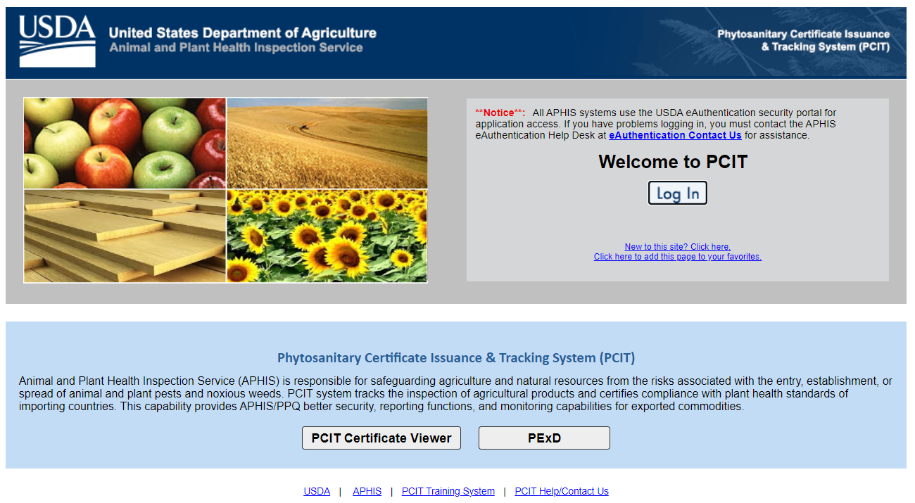
U.S. Update 2023

Slide 15
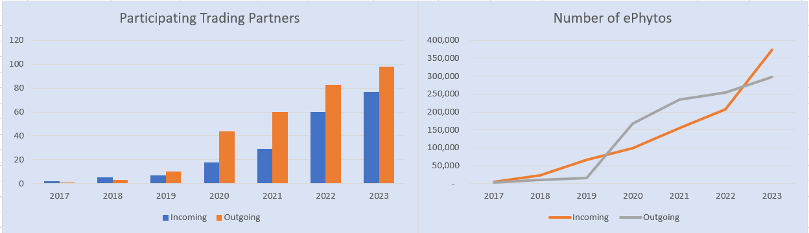
U.S. Update 2023
https://www.aphis.usda.gov/aphis/ourfocus/planthealth/sa_export/ephyto-participating-countries

Slide 16
Thanks and Questions?

